Slide 1
Application Delivery Fundamentals 2.0 B: Java
Micro Service

Slide 2
Micro Service
Goals
Independent deployment of components
Independent scaling of components
Independent implementation stacks for each component
Easy self-serve deployments of components
Repeatable deployments of components (external configuration management)
Deployments without service interruptions

Slide 3
Micro Service
Goals
Protection of system availability from individual Instance failure
Automatic replacement of component instances when they fail (self-healing)
Easy scaling of components by adjusting a simple parameter value
Canary testing (A canary deployment / canary test allows you to gradually release new features to a subset of your users while still serving your current branch to the rest of your users)
"Red/black" or "blue/green" deployments(Instant reversal of new revision deployments)

Slide 4
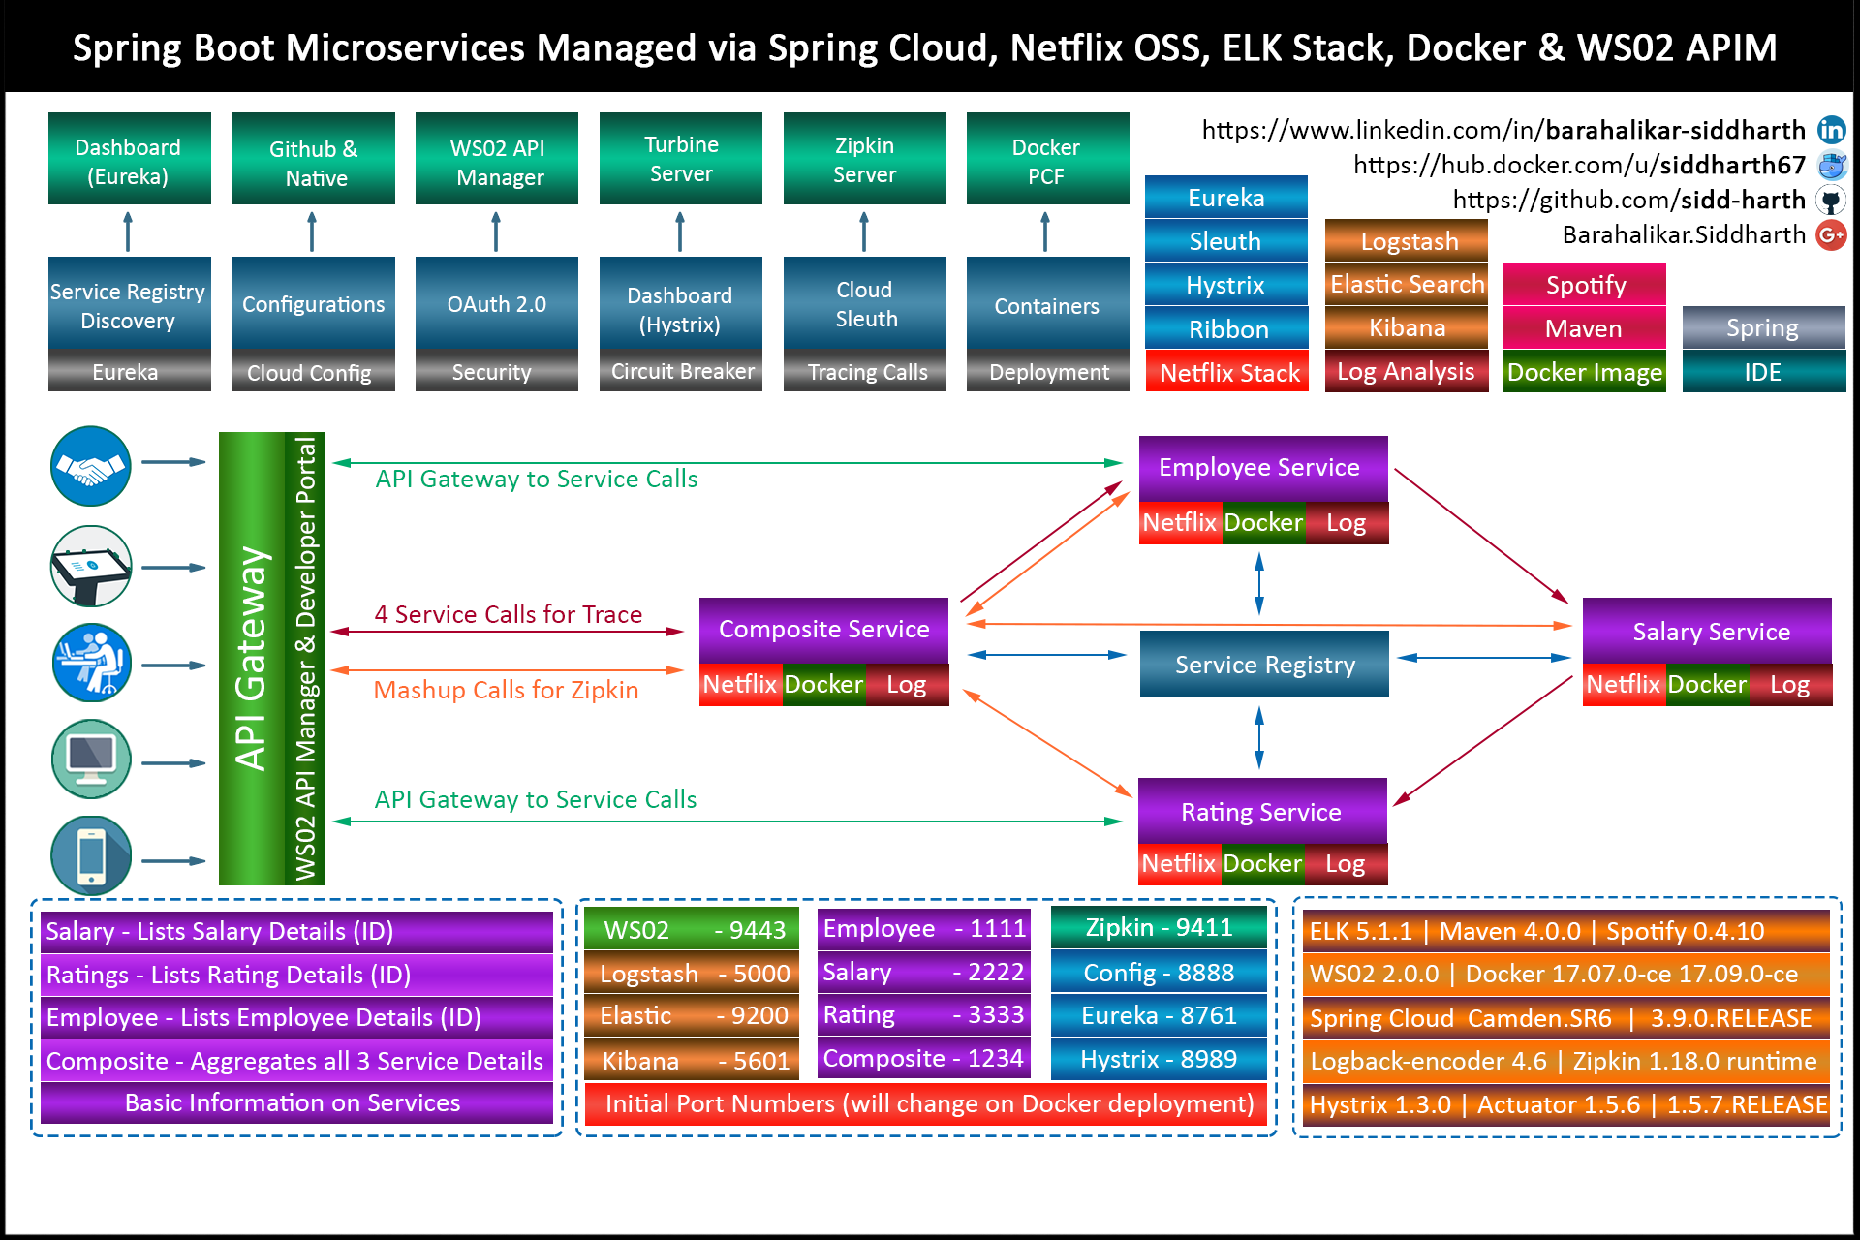

Slide 5
Monolithic Architecture
Monolith means composed all in one piece.
The Monolithic application describes a single-tiered software application in which different components combined into a single program from a single platform.

Slide 6
Monolithic Architecture
Components can be:
Authorization — responsible for authorizing a user
Presentation — responsible for handling HTTP requests and responding with either HTML or JSON/XML (for web services APIs).
Business logic — the application’s business logic.
Database layer — data access objects responsible for accessing the database.
Application integration — integration with other services (e.g. via messaging or REST API). Or integration with any other Data sources.
Notification module — responsible for sending email notifications whenever needed.

Slide 7
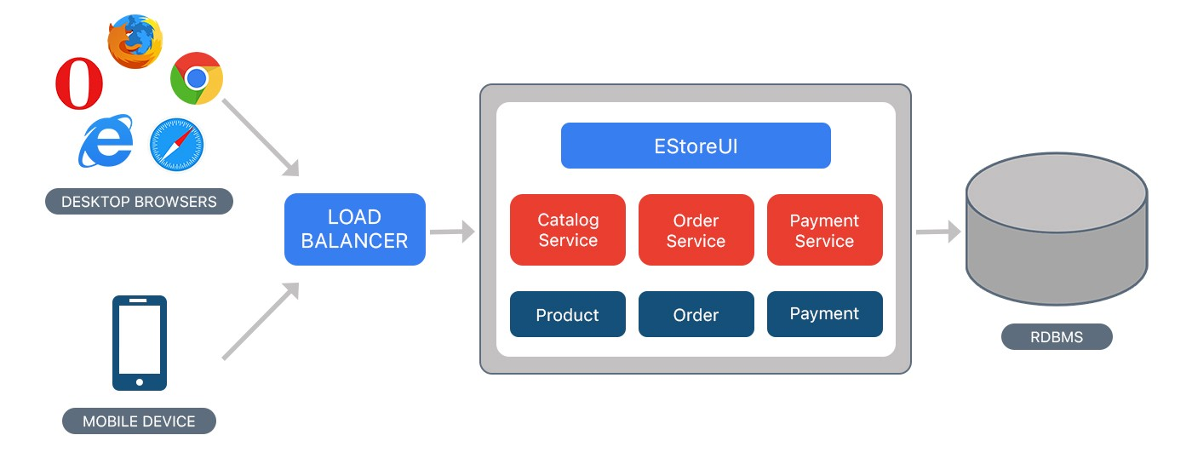
Example of Monolithic Approach

Slide 8
Drawbacks
Maintenance — If Application is too large and complex to understand entirely, it is challenging to make changes fast and correctly.
The size of the application can slow down the start-up time.
You must redeploy the entire application on each update.
Monolithic applications can also be challenging to scale when different modules have conflicting resource requirements.
Reliability — Bug in any module (e.g. memory leak) can potentially bring down the entire process.
Moreover, since all instances of the application are identical, that bug impact the availability of the entire application

Slide 9
Drawbacks
Regardless of how easy the initial stages may seem, Monolithic applications have difficulty to adopting new and advance technologies.
Since changes in languages or frameworks affect an entire application.
It requires efforts to thoroughly work with the app details.
Hence it is costly considering both time and efforts.

Slide 10
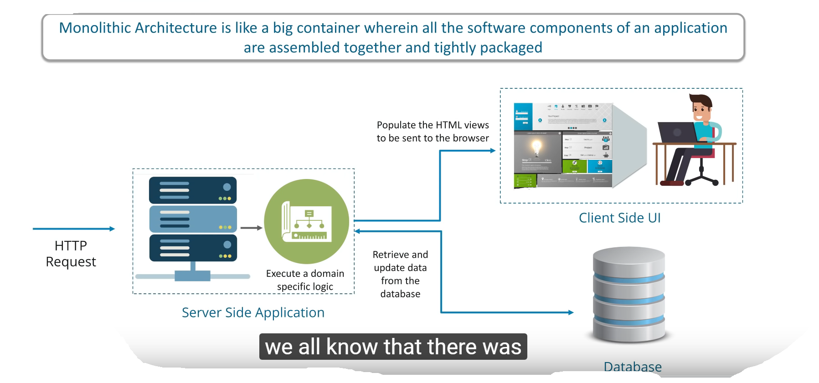
Monolithic Architecture

Slide 11
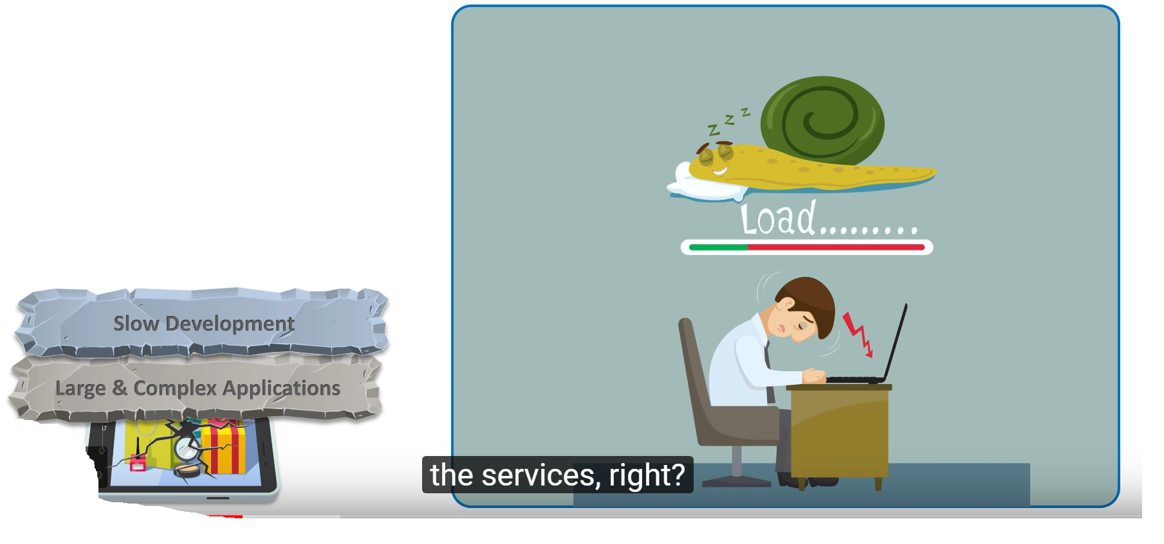
Monolithic Architecture

Slide 12
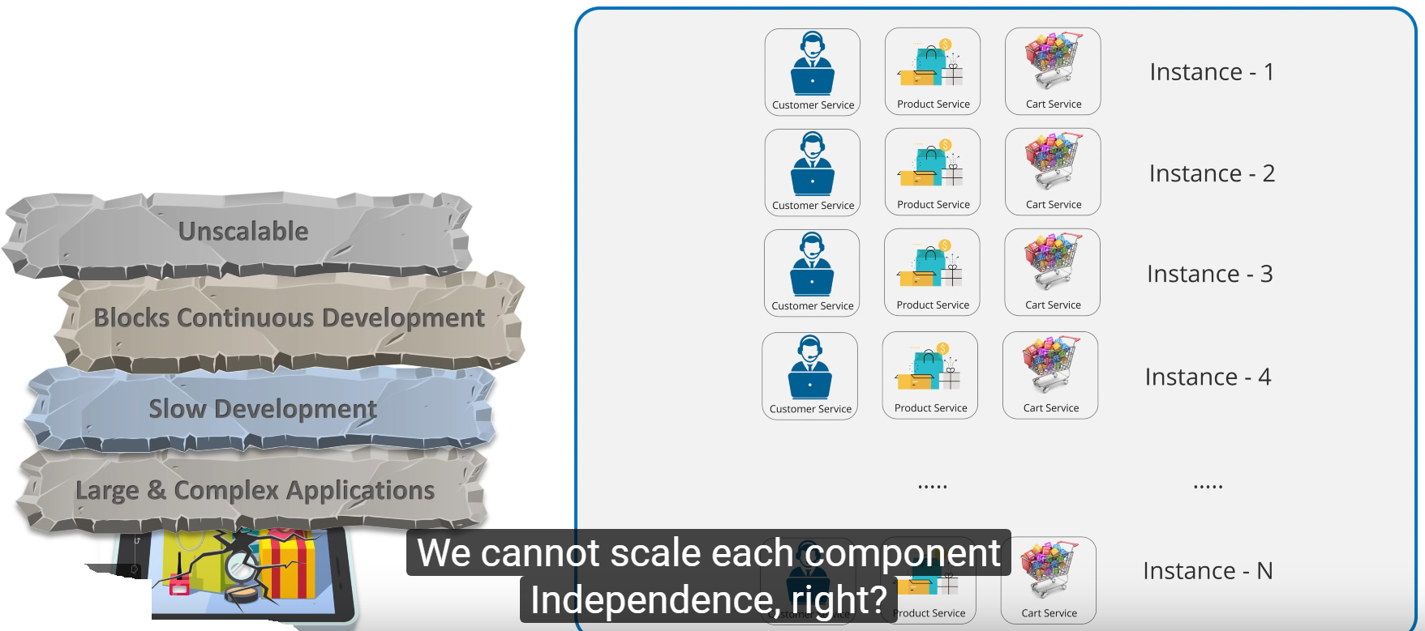
Monolithic Architecture

Slide 13
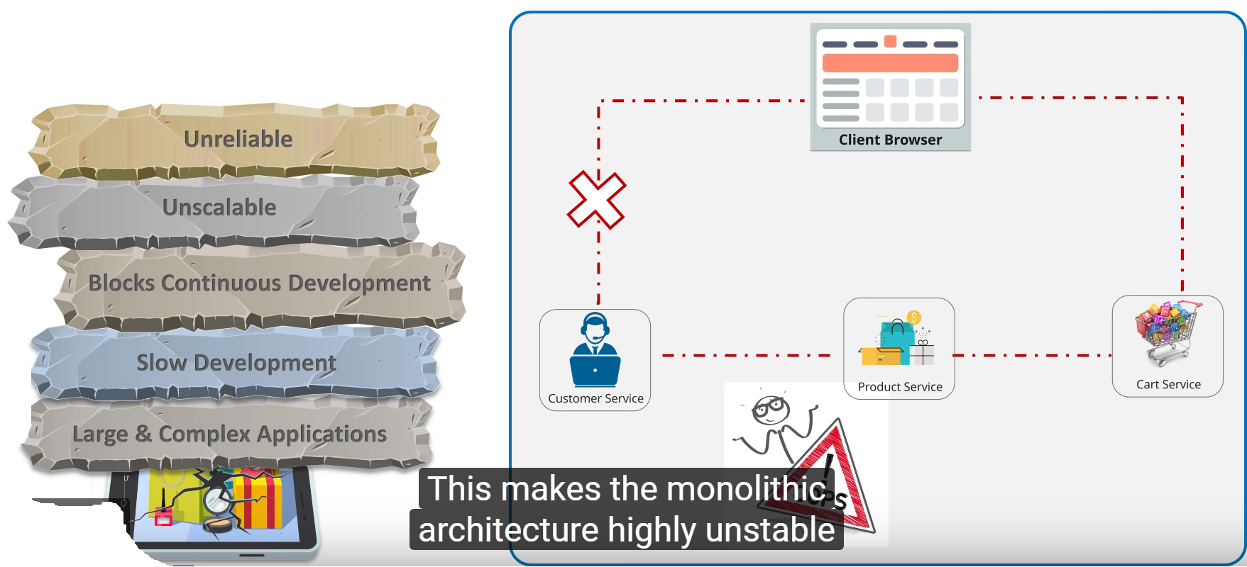
Monolithic Architecture

Slide 14
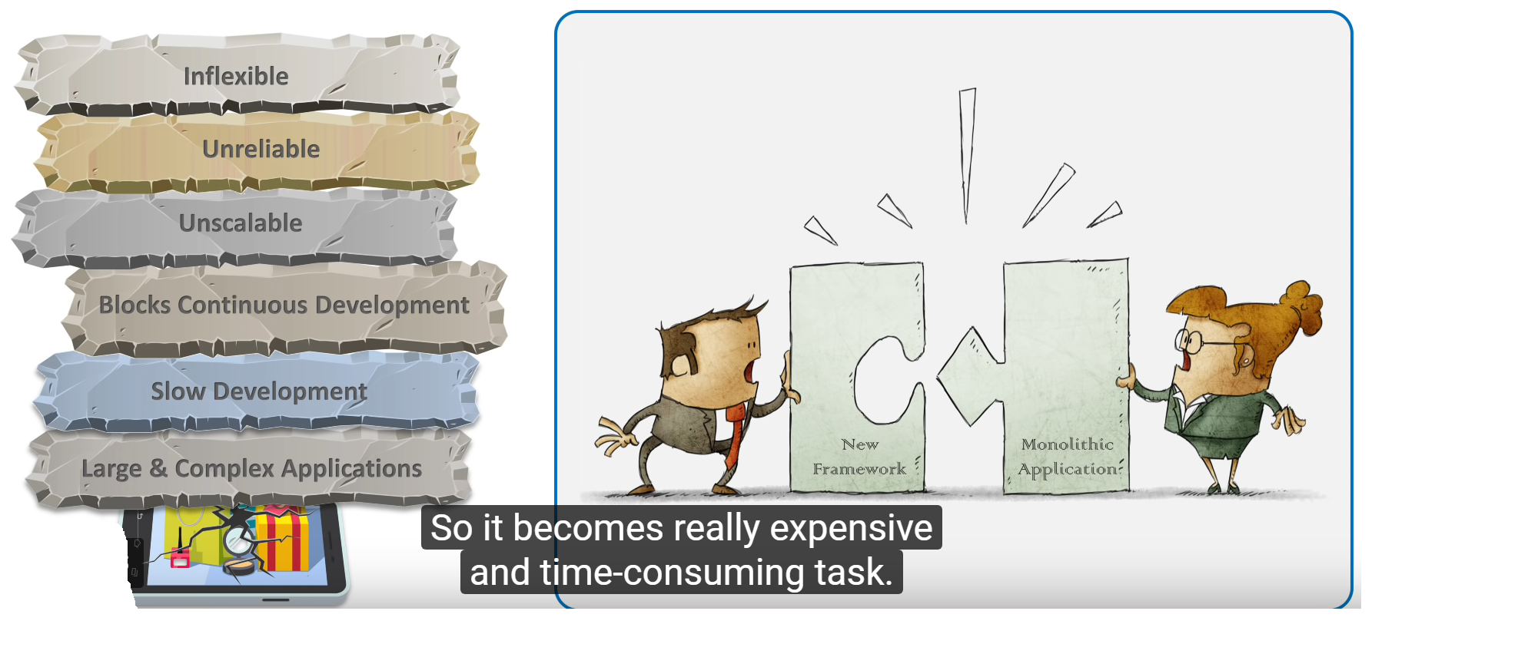
Monolithic Architecture

Slide 15
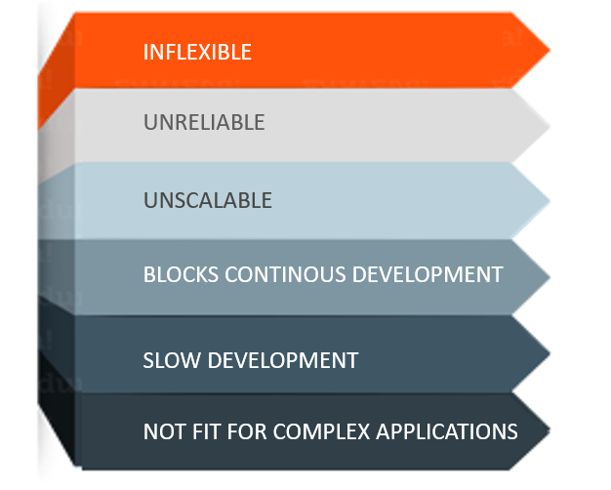
Monolithic Architecture

Slide 16
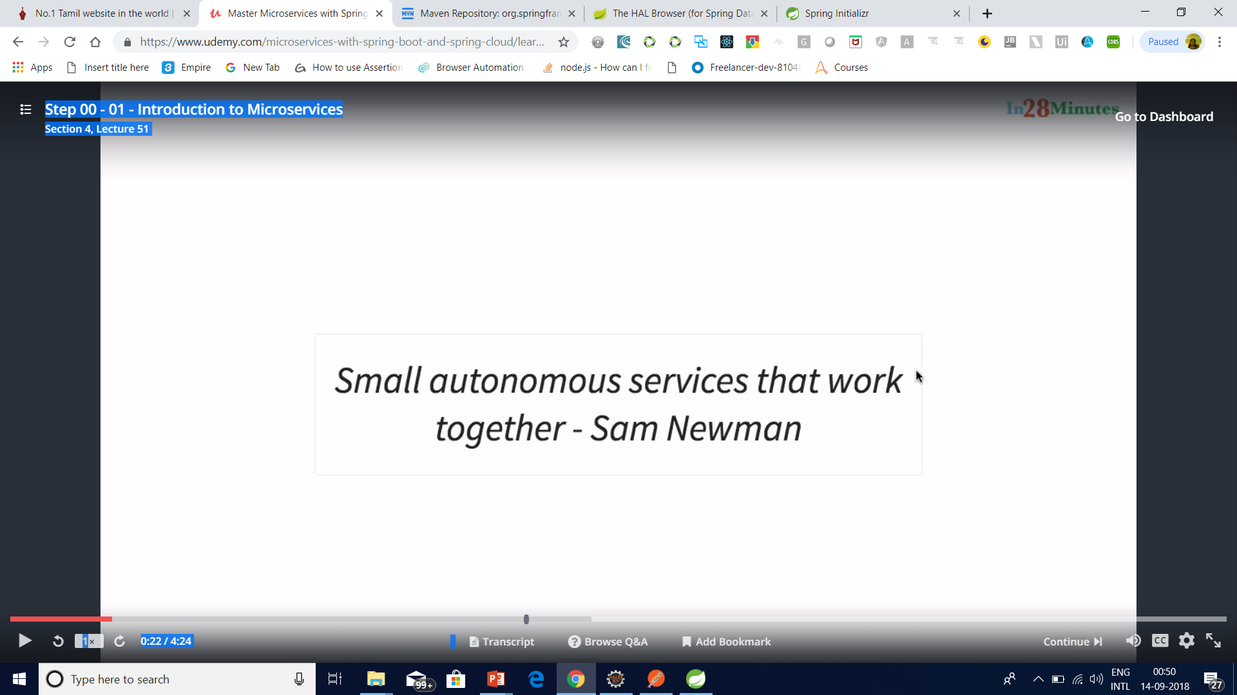
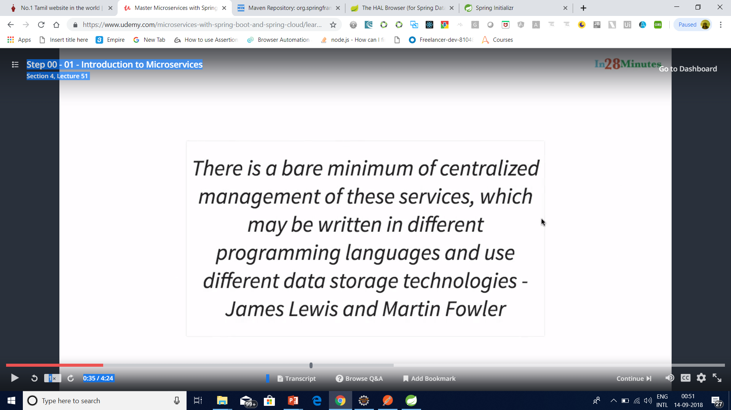
Micro Service

Slide 17
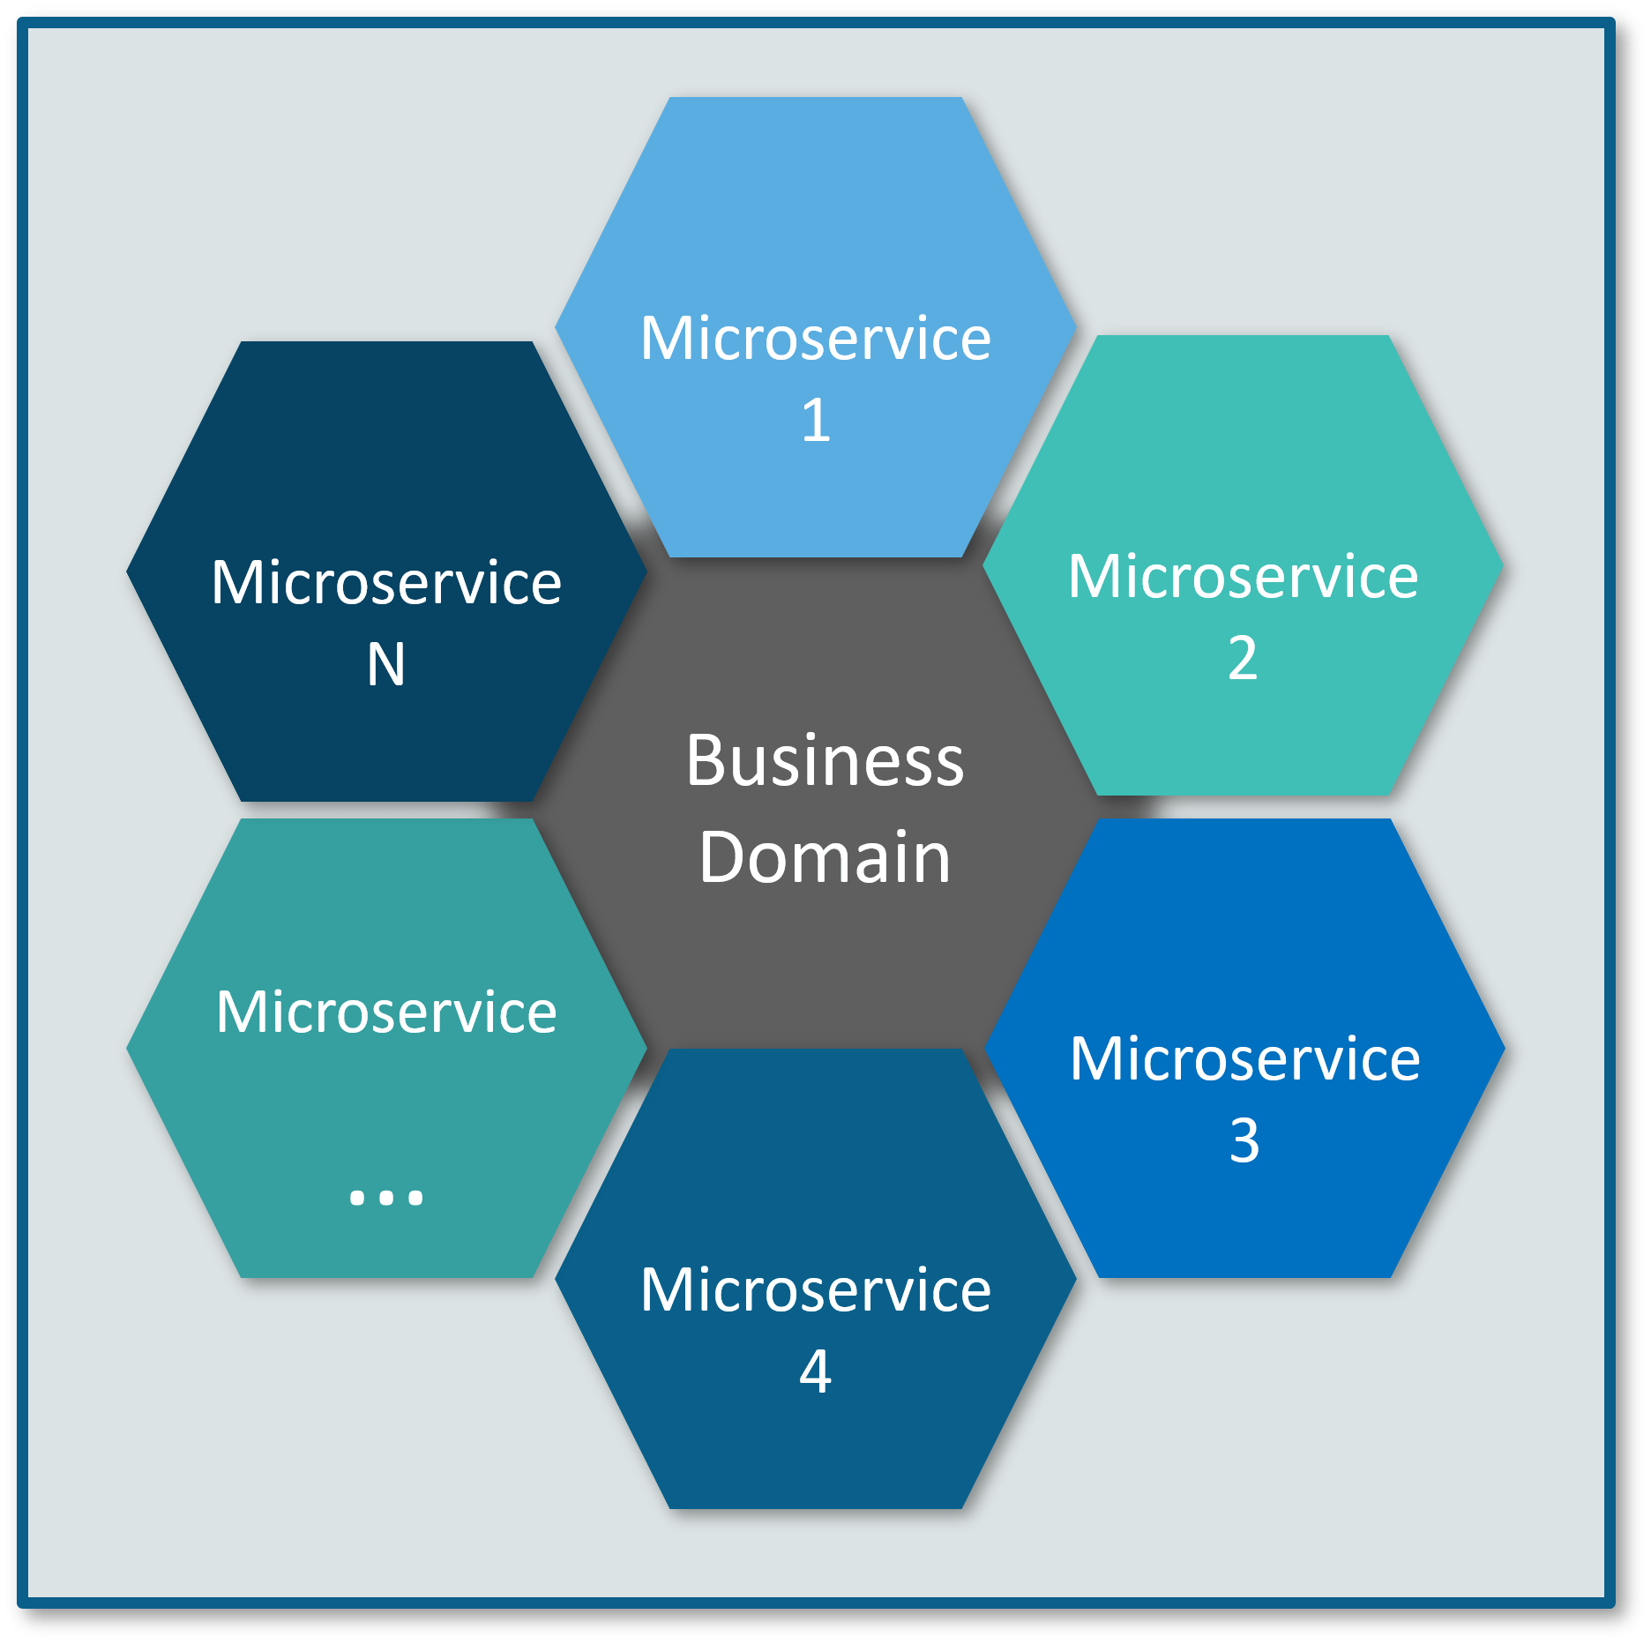
Microservice

Slide 18

Micro Service

Slide 19
Micro Service

Slide 20

Micro Service

Slide 21

Micro Service

Slide 22
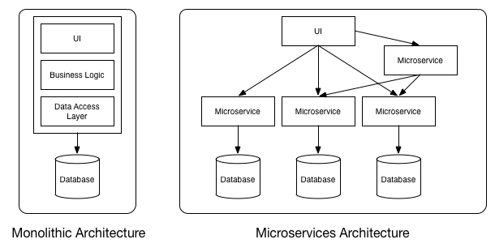
Microservice

Slide 23
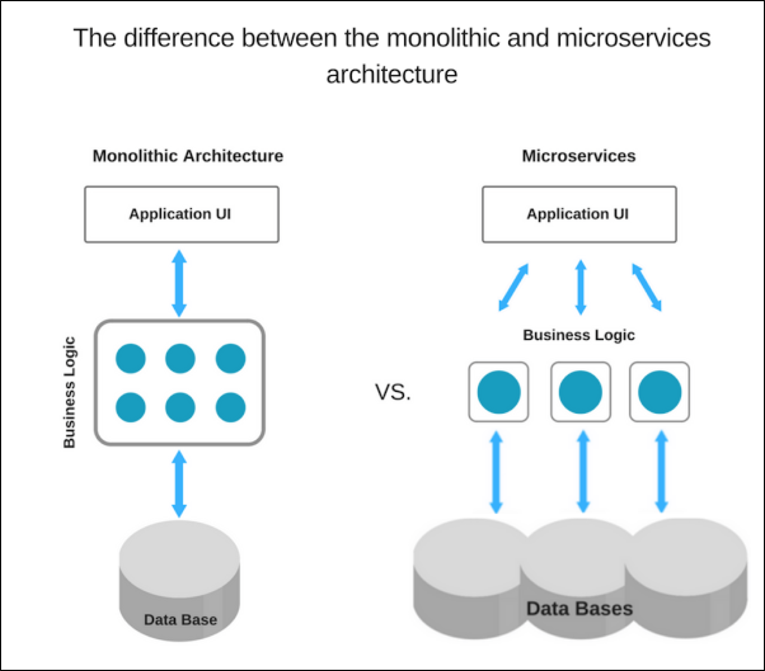
MicroService

Slide 24
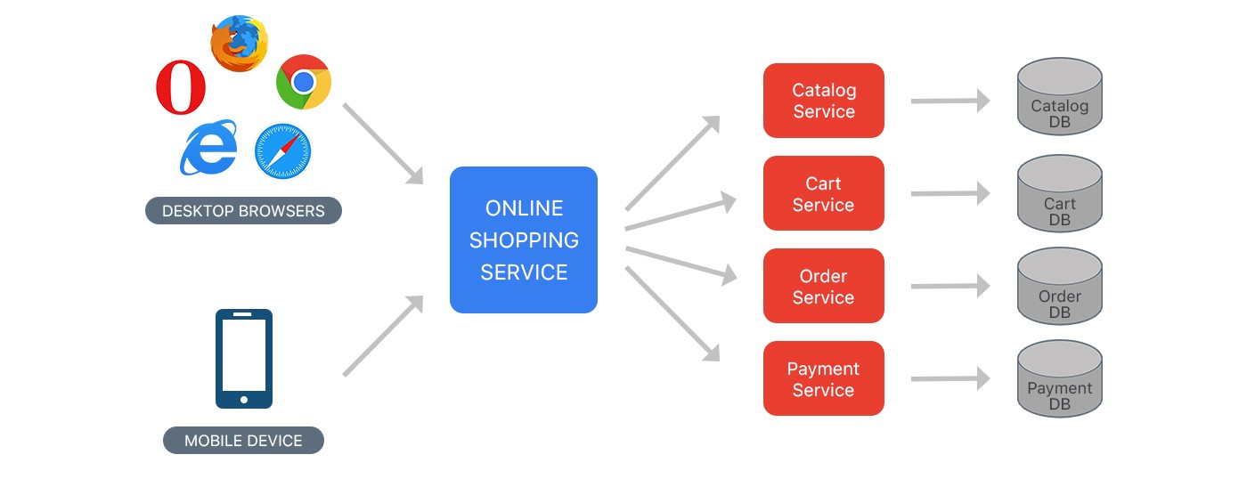
Micro Service

Slide 25
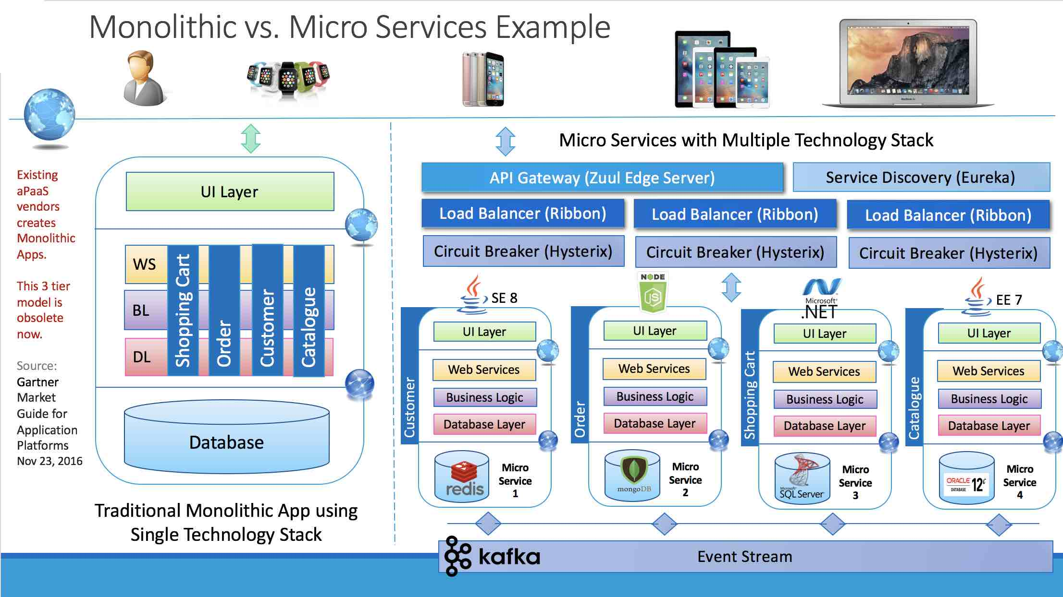

Slide 26
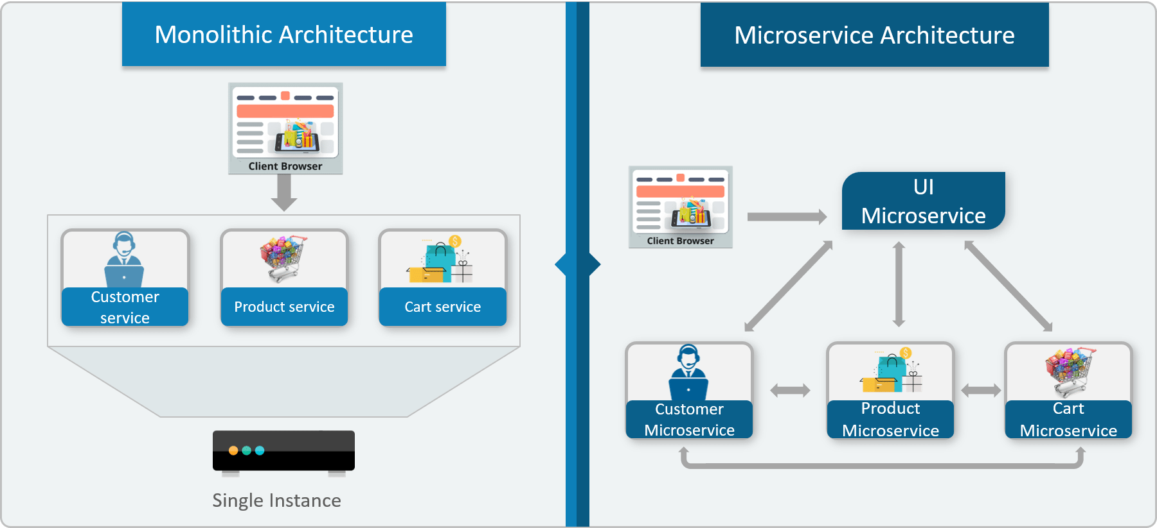

Slide 27
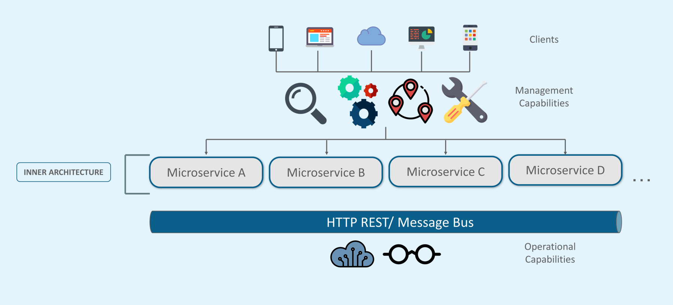
Microservice Architecture

Slide 28
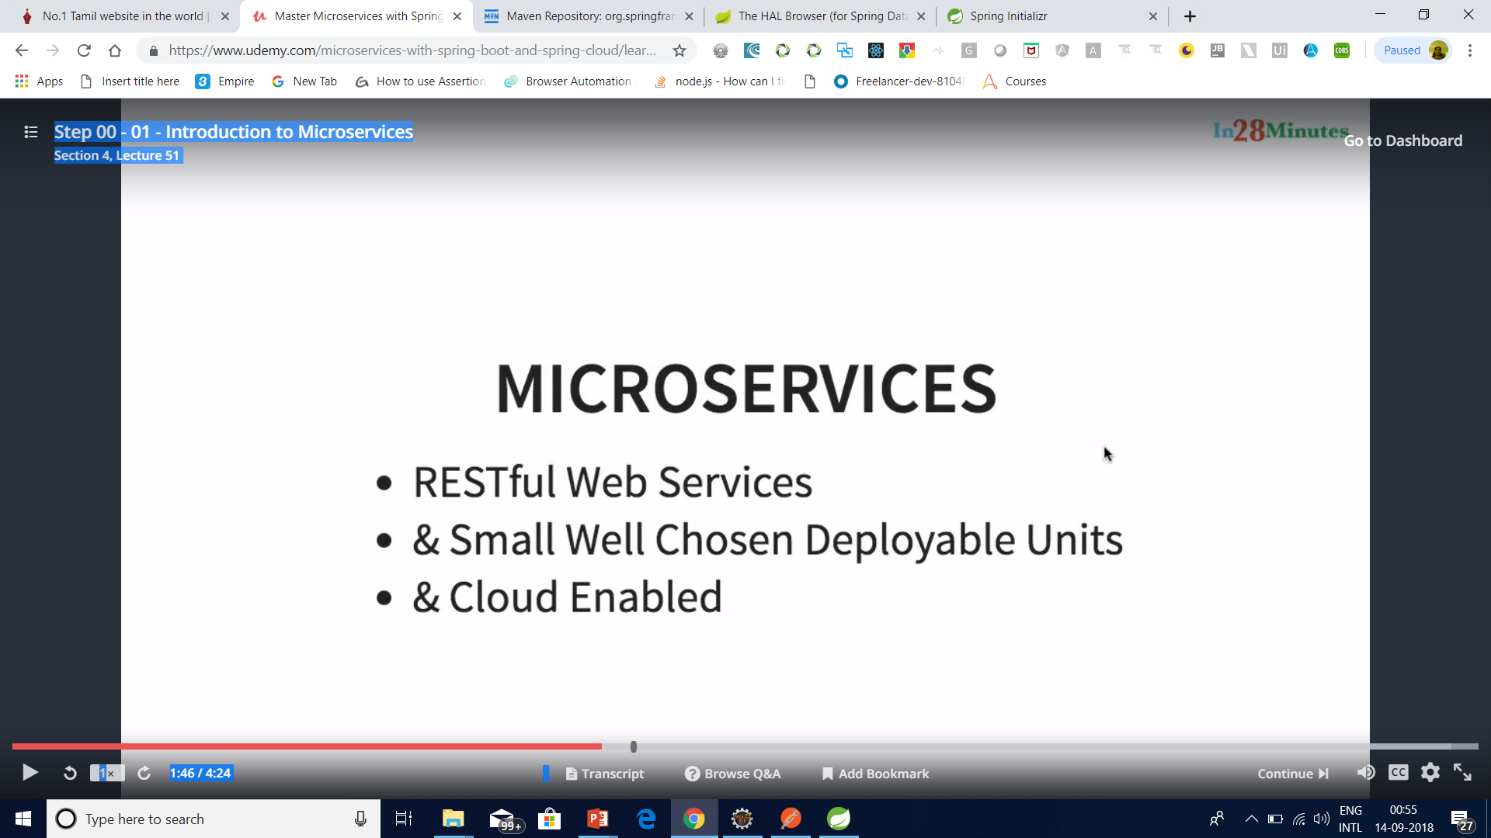
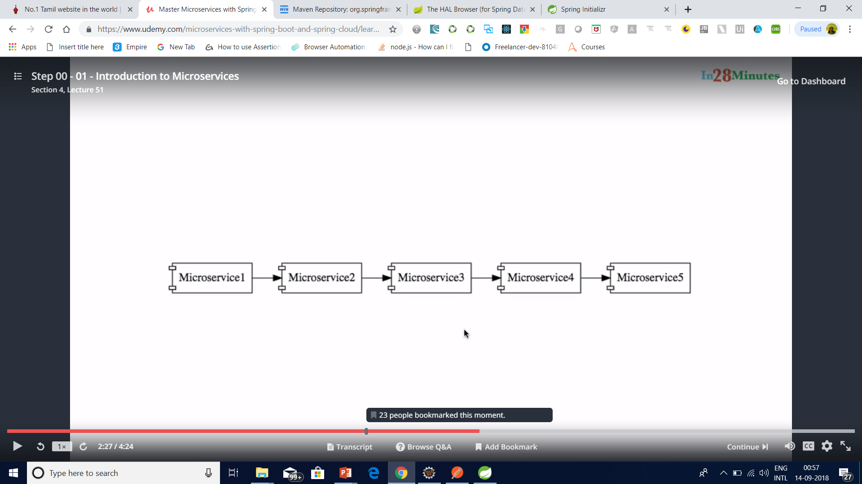
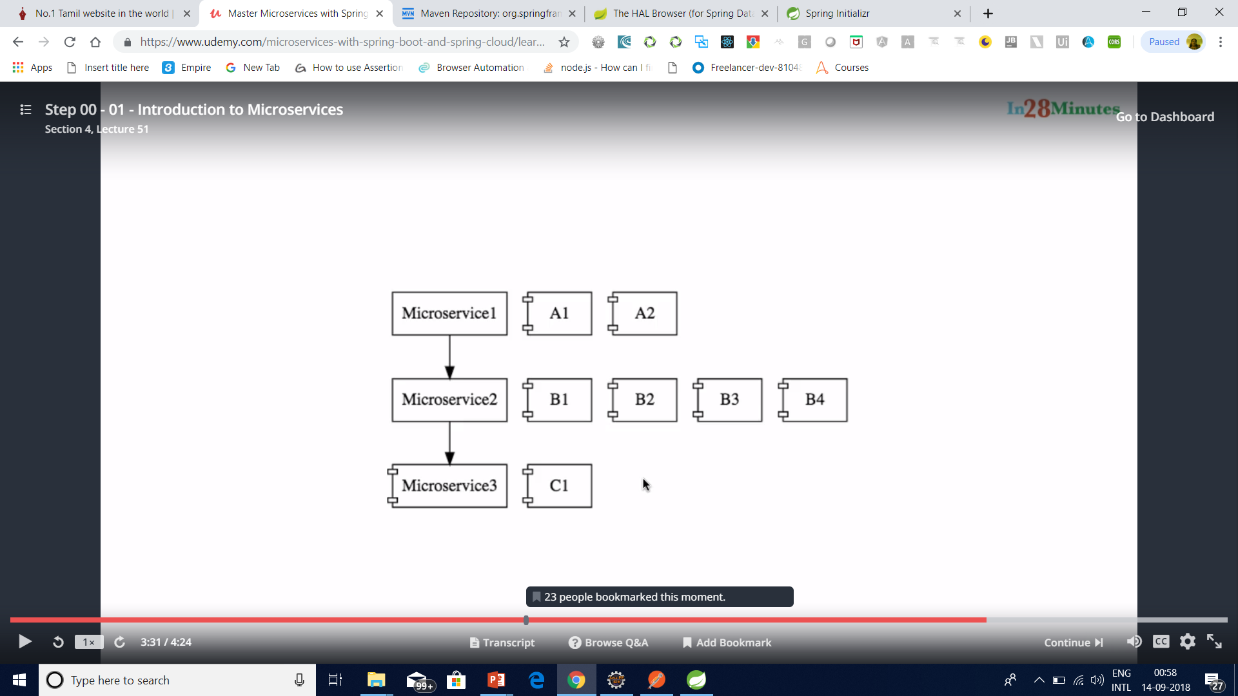
Micro Service

Slide 29
What is Microservice
Microservices is a variant of the service-oriented architecture (SOA) architectural style that structures an application as a collection of loosely coupled services.

Slide 30
What is Microservice
In a microservices architecture, services should be fine-grained and the protocols should be lightweight.
The benefit of decomposing an application into different smaller services is that it improves modularity and makes the application easier to understand, develop and test.

Slide 31
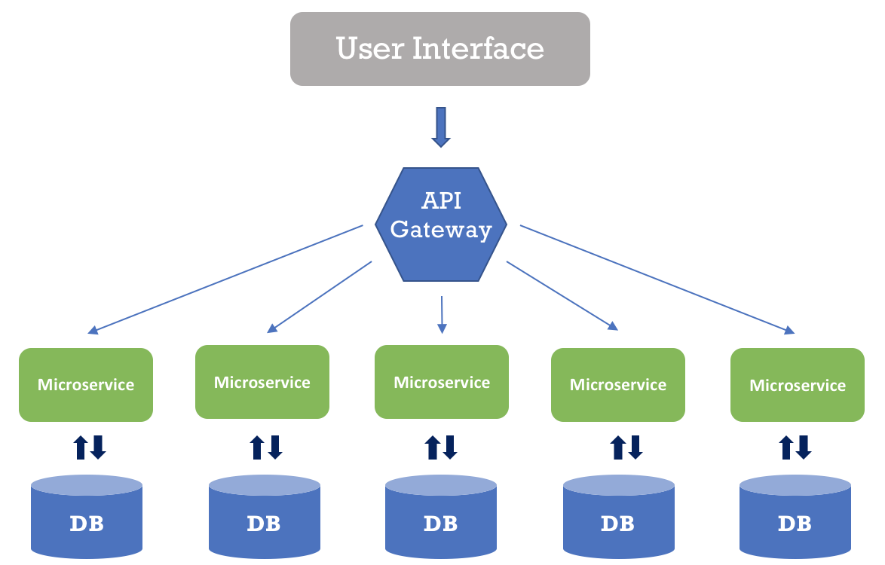
What is Microservices
It also parallelizes development by enabling small autonomous teams to develop, deploy and scale their respective services independently.

Slide 32
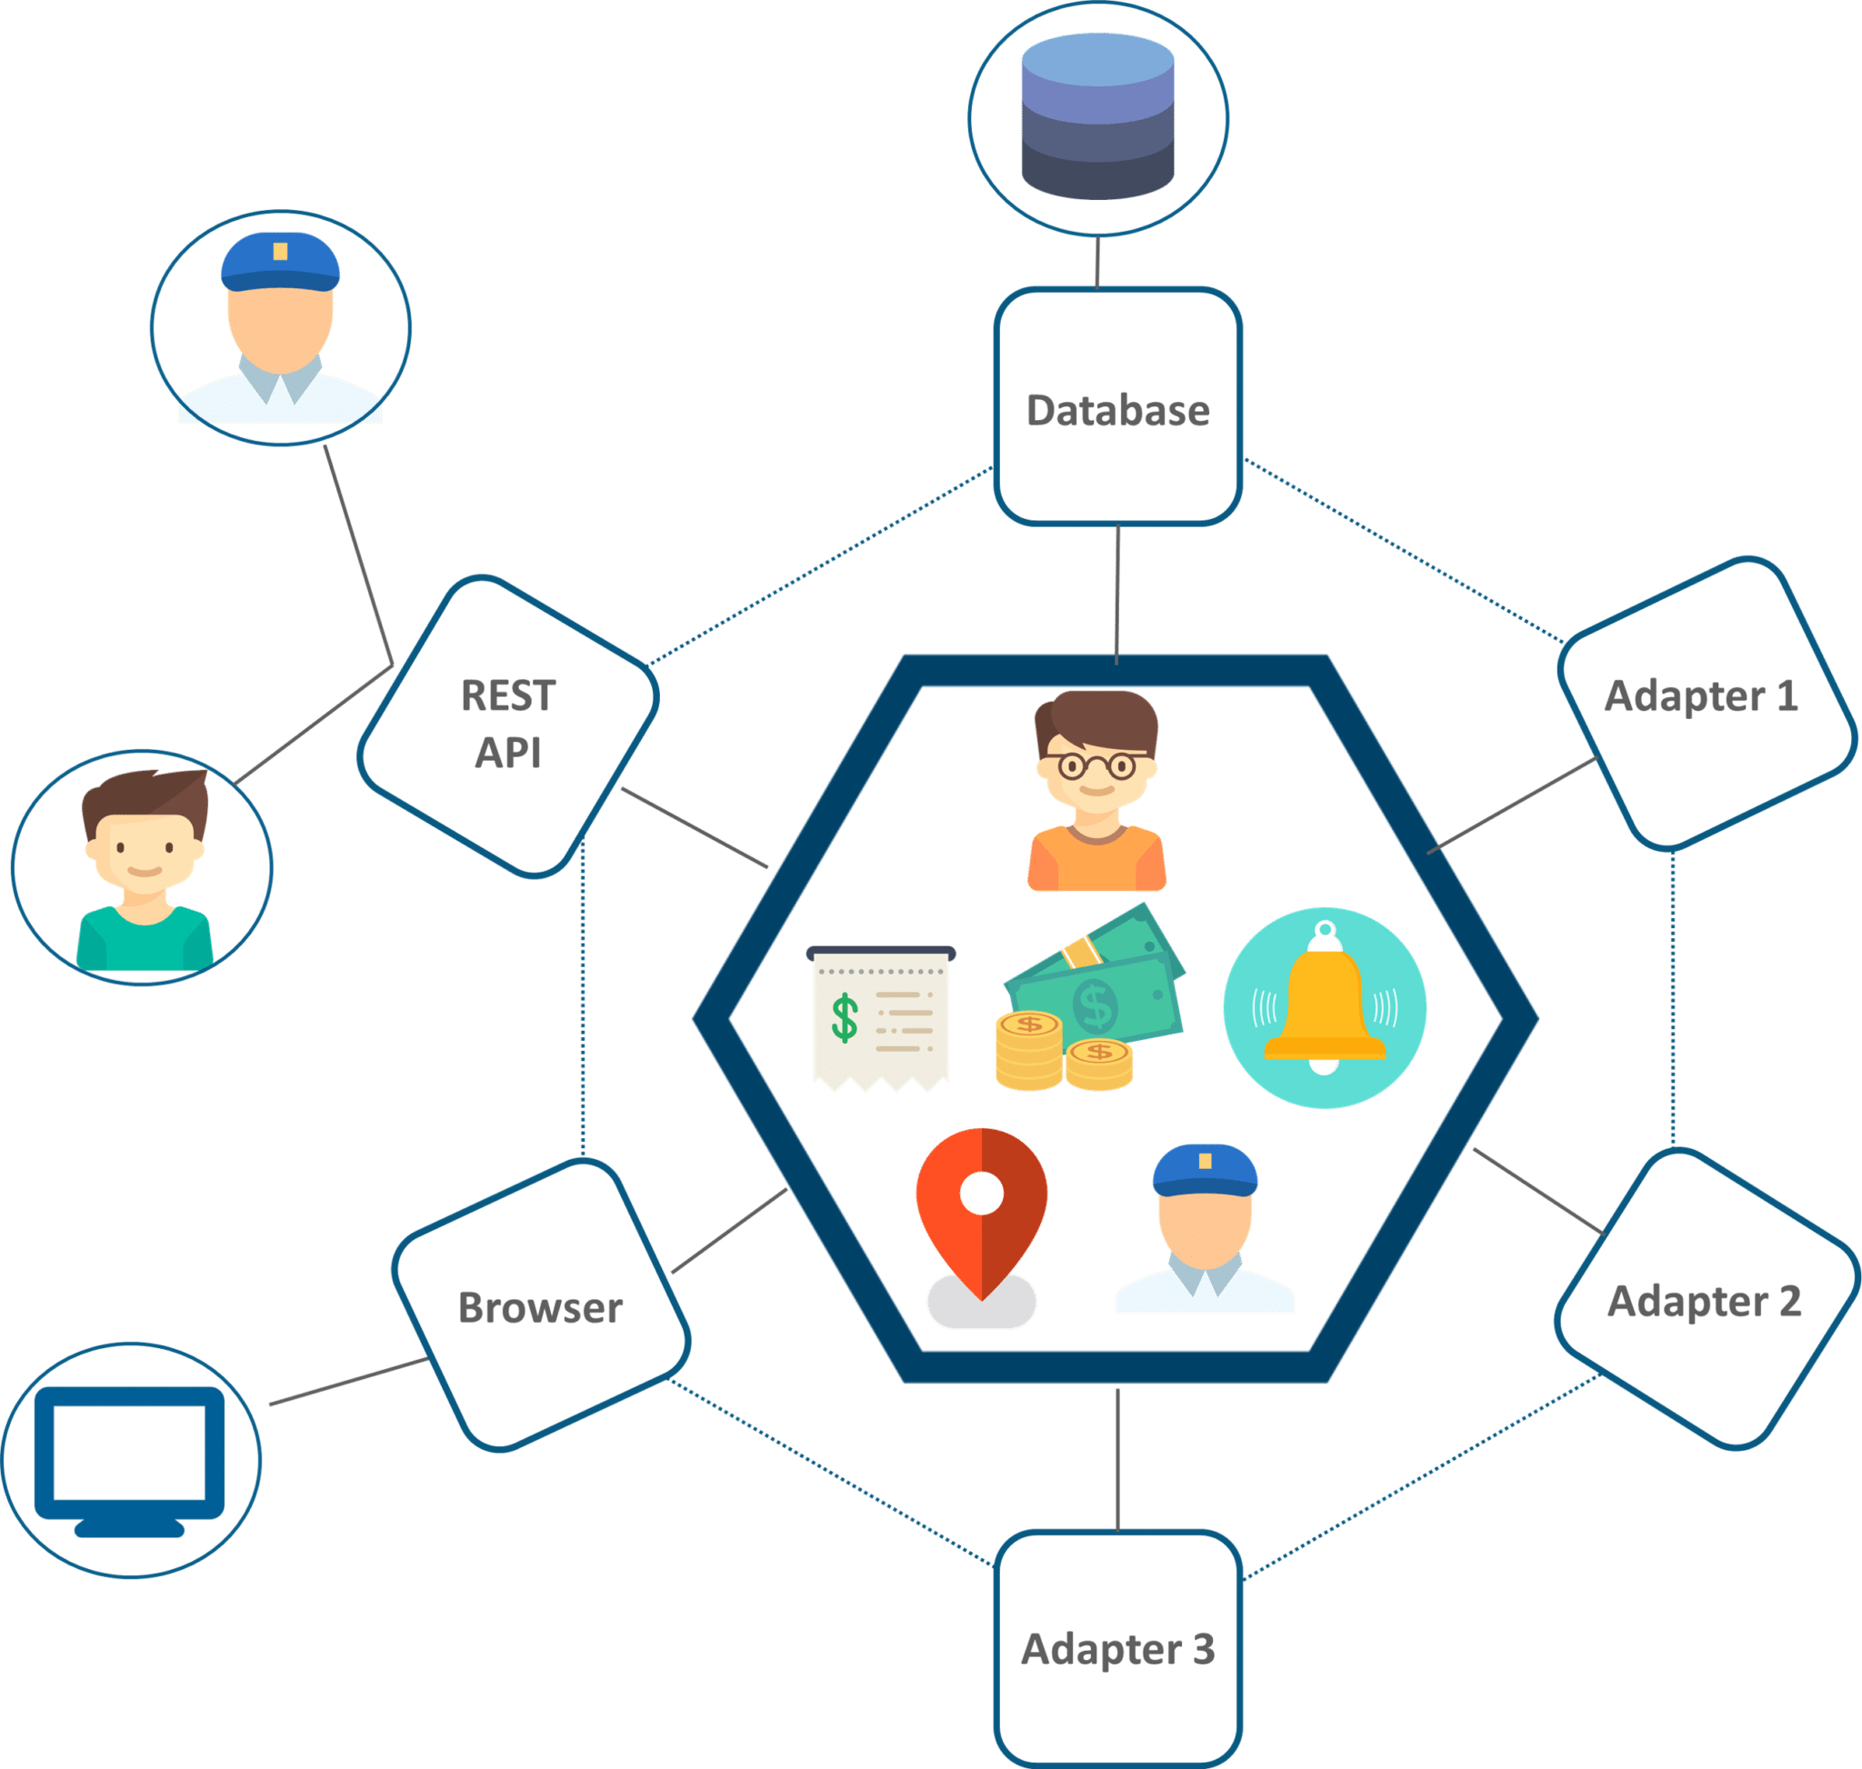
UBER CASE STUDY
UBER’s Previous Architecture

Slide 33
Problem Statement
While UBER started expanding worldwide this kind of framework introduced various challenges. The following are some of the prominent challenges
All the features had to be re-built, deployed and tested again and again to update a single feature.
Fixing bugs became extremely difficult in a single repository as developers had to change the code again and again.
Scaling the features simultaneously with the introduction of new features worldwide was quite tough to be handled together.

Slide 34
Solution
To avoid such problems UBER decided to change its architecture and follow the other hyper-growth companies like Amazon, Netflix, Twitter and many others.
Thus, UBER decided to break its monolithic architecture into multiple codebases to form a microservice architecture.

Slide 35
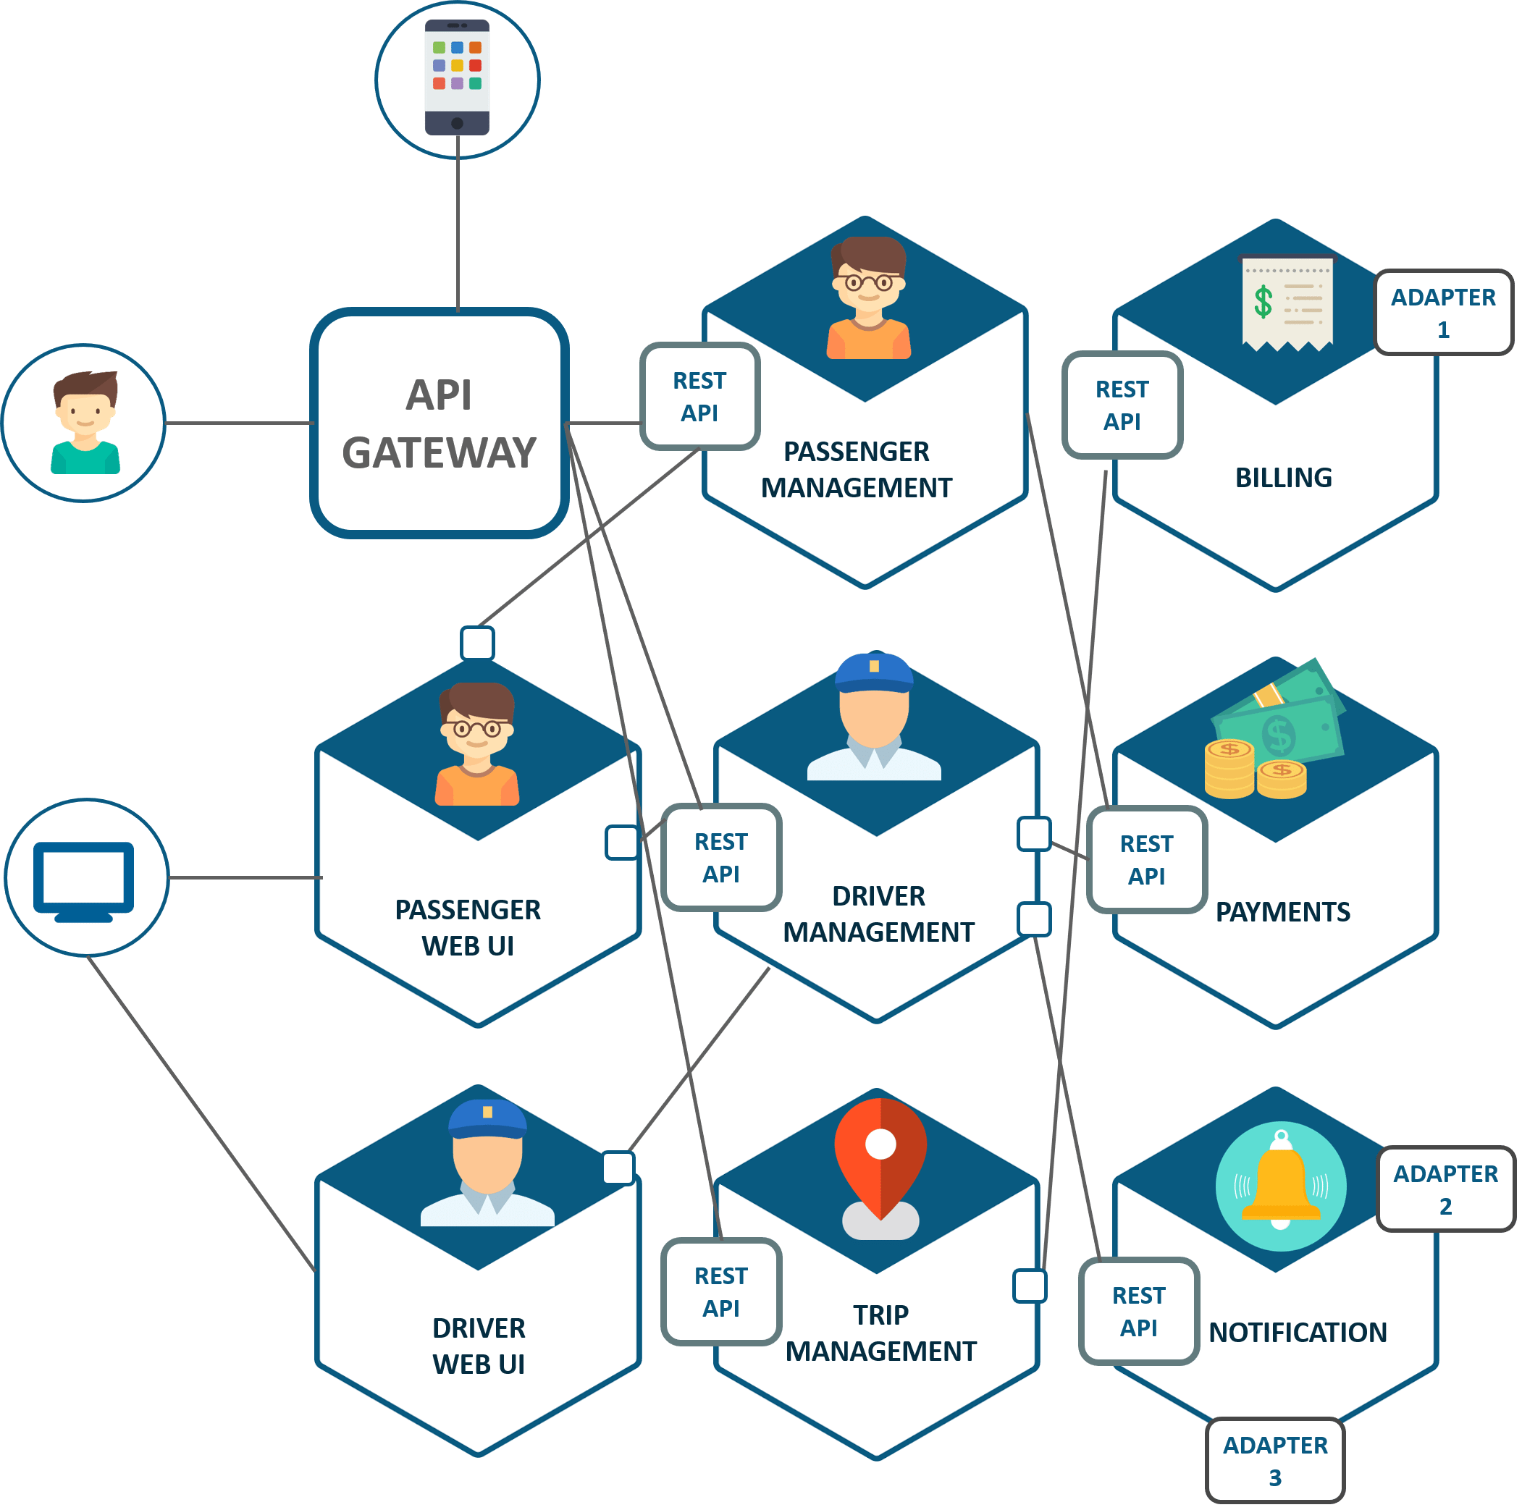

Slide 36
Existing Scenarios
Netflix has a widespread architecture that has evolved from monolithic to SOA.
It receives more than one billioncalls every day, from more than 800 different types of devices, to its streaming-video API.
Each API call then prompts around five additional calls to the backend service.
Amazon has also migrated to microservices.
They get countless calls from a variety of applications—including applications that manage the web service API as well as the website itself—which would have been simply impossible for their old, two-tiered architecture to handle.
The auction site eBay is yet another example that has gone through the same transition.
Their core application comprises several autonomous applications, with each one executing the business logic for different function areas.

Slide 37
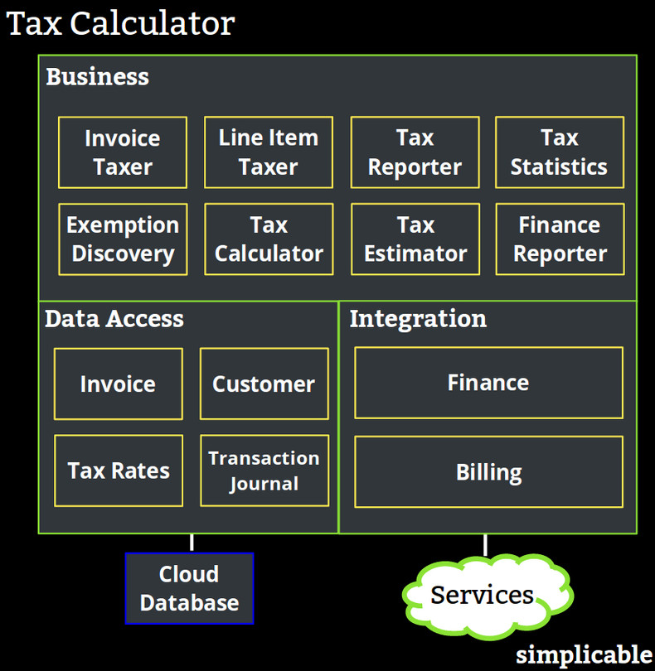

Slide 38
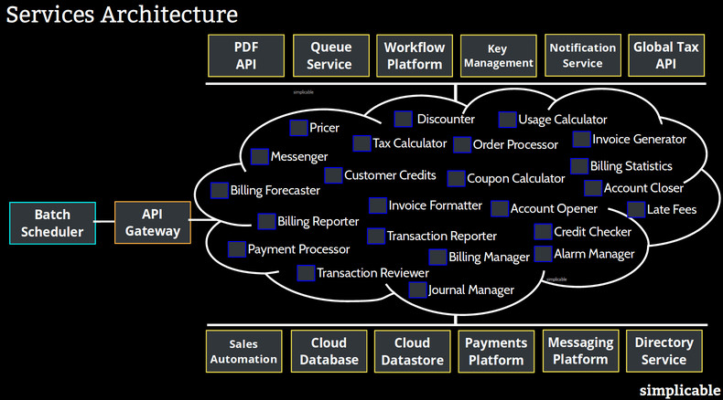

Slide 39
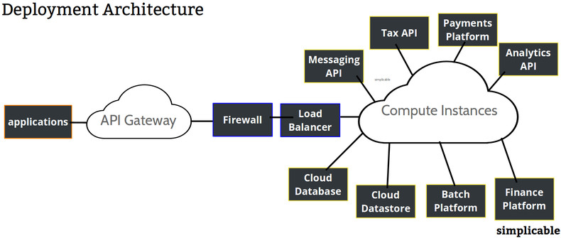

Slide 40
Principles of Micro service
Independent & Autonomous Services
Scalability
Decentralization
Resilient Services
Real-Time Load Balancing
Availability
Continuous delivery through DevOps Integration
Seamless API Integration and Continuous Monitoring
Isolation from Failures
Auto -Provisioning

Slide 41
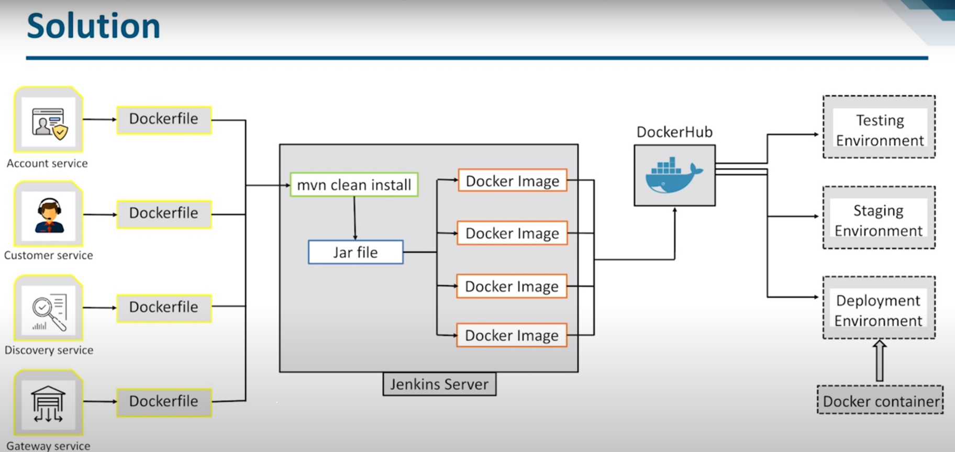
Continuous delivery through DevOps Integration

Slide 42
API Integration ESB or Microservices

Slide 43
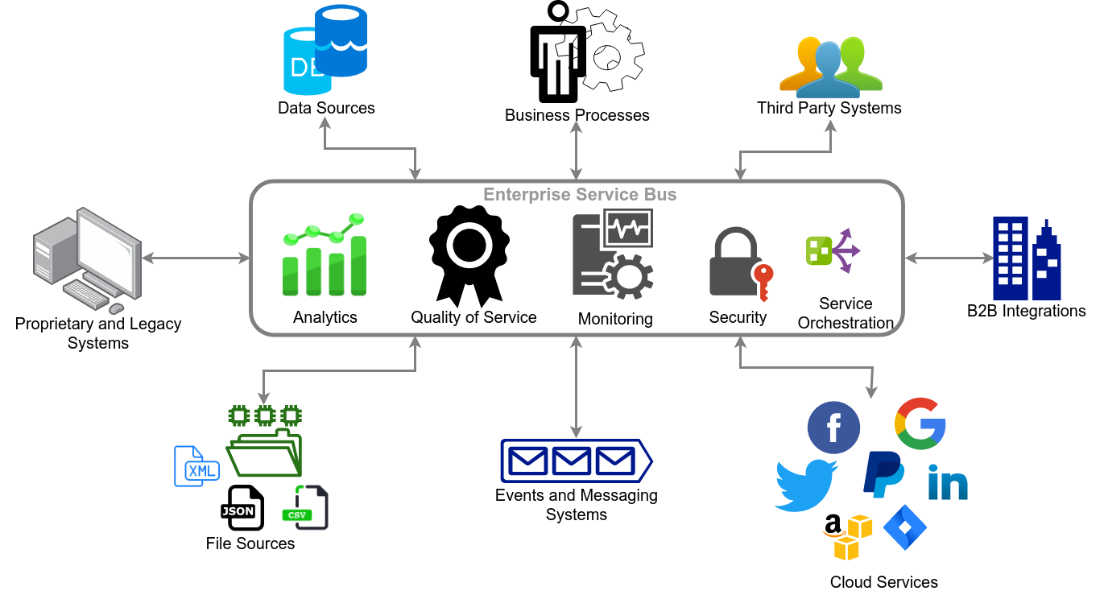
ESB for API Integration

Slide 44
Disadvantages of ESB
Added delay in round-trip
Connectivity requirements(All calls through ESB)
Single point of failure
Complexity in scalability

Slide 45
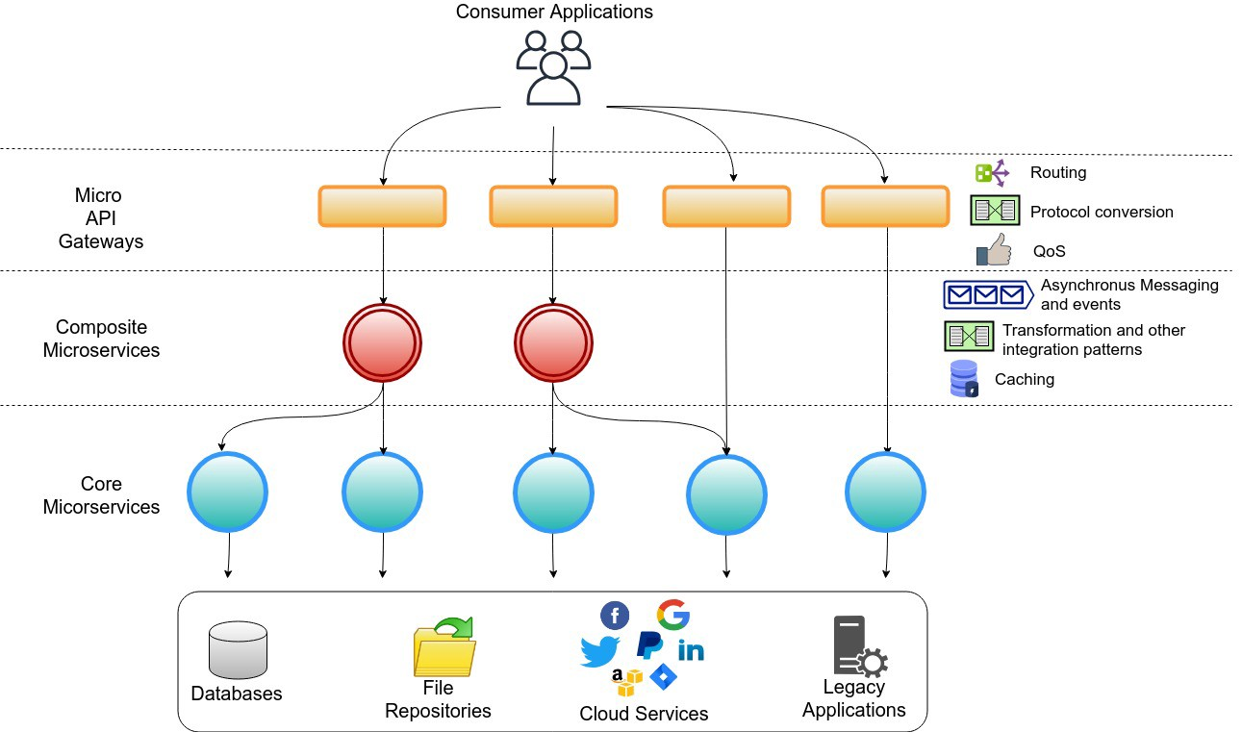
Microservice for API Integration

Slide 46
ESB or Microservice
When you select the suitable solution for the organization, following factors need to be assessed.
Types of services to be integrated
Communication protocols required
Performance numbers
Transaction requirements
Security restrictions
Inter-dependencies of services
Business timelines
Target expenses for the infrastructure
Skill set of the team

Slide 47
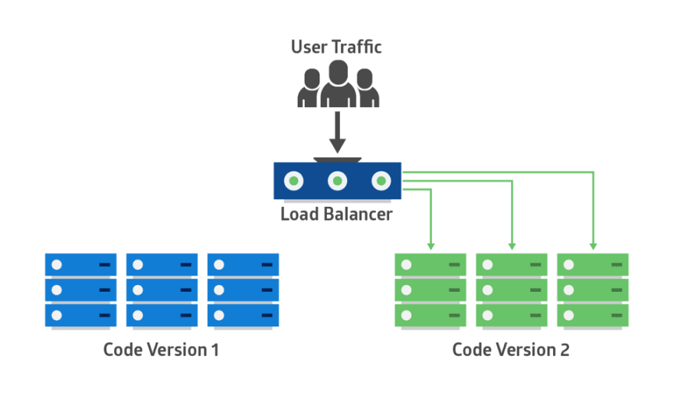
Blue Green Deployment

Slide 48
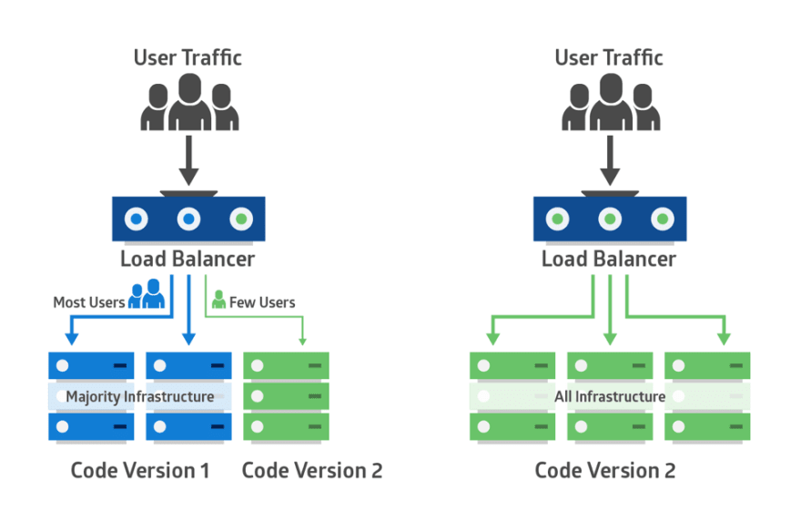
Canary Testing

Slide 49
TWELVE-FACTOR APPS AND MICROSERVICES
Modern architecture aims to develop large and complex applications in software as service (SaaS) models.
The twelve-factor methodology provides guidelines for developing SaaS-based applications.
Microservices, containers and their ecosystem fit well into the twelve-factor methodology.

Slide 50
TWELVE-FACTOR APPS AND MICROSERVICES

Slide 51
TWELVE-FACTOR APPS AND MICROSERVICES

Slide 52
Microservice Reference Architecture

Slide 53
Sample Microservice Interaction

Slide 54
Sample Microservice Interaction

Slide 55
Sample Microservice Interaction

Slide 56
Cloud Deployment Architecture - AWS
Cloudfront CDN: Cloudfront native CDN allows to effectively deliver the content for the consumer from different geographies.
• S3 Bucket: ReactJS/Angular-based web applications will be deployed on S3 bucket & it is integrated with AWS Cloud front. The frontend is secured with WAF (Web Application Firewall). Deploying frontend static content on S3 makes it highly scalable & cost effective.
• Custom Services Layer: Backend microservices are developed using NodeJS/ Spring Boot and are deployed on containers using AWS Cloud-native container orchestration services ECS. These services are accessed through AWS API Gateway.

Slide 57
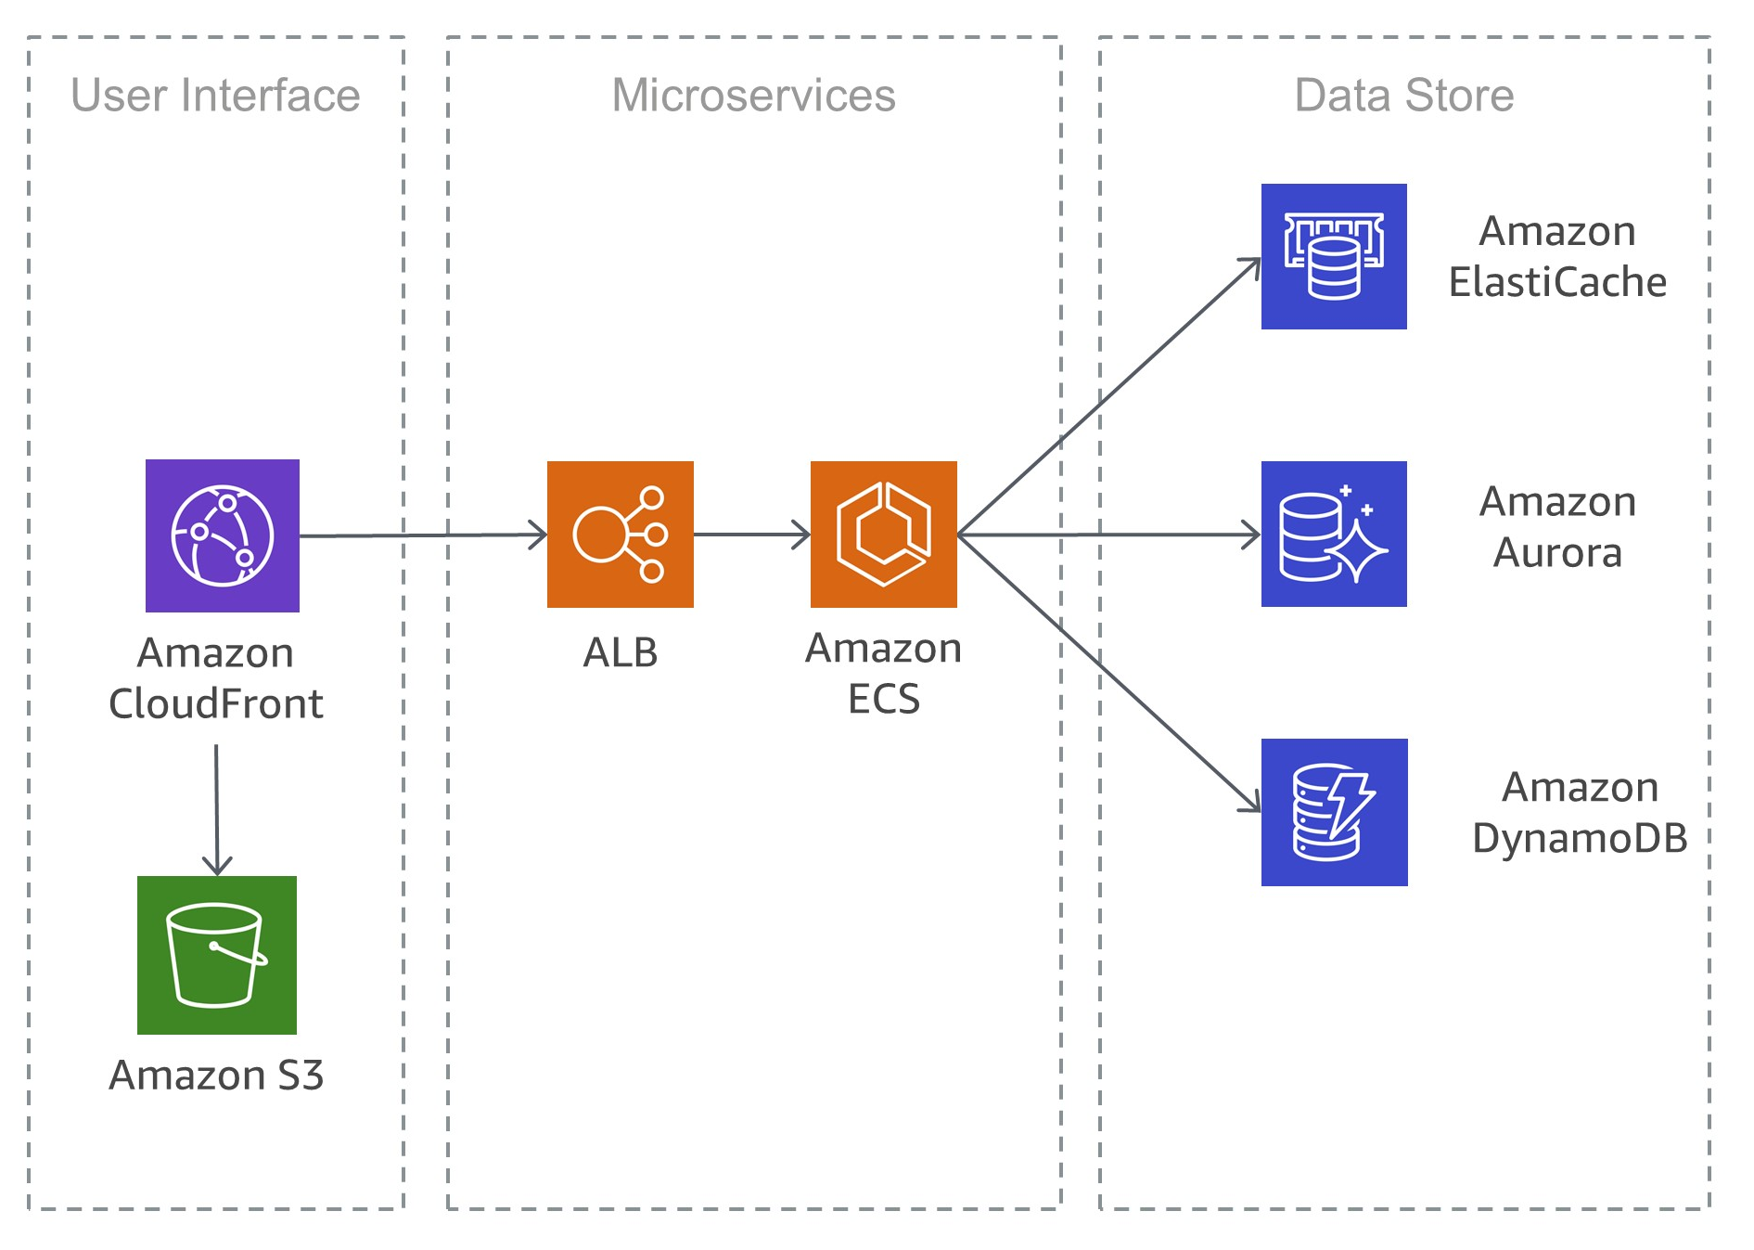
Simple Microservices Architecture on AWS

Slide 58
Cloud Deployment Architecture - AWS

Slide 59
Cloud Deployment Architecture - Azure

Slide 60
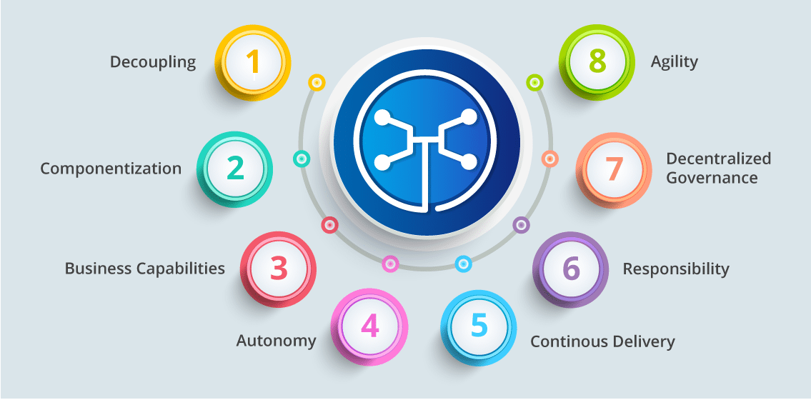
Microservices Features

Slide 61
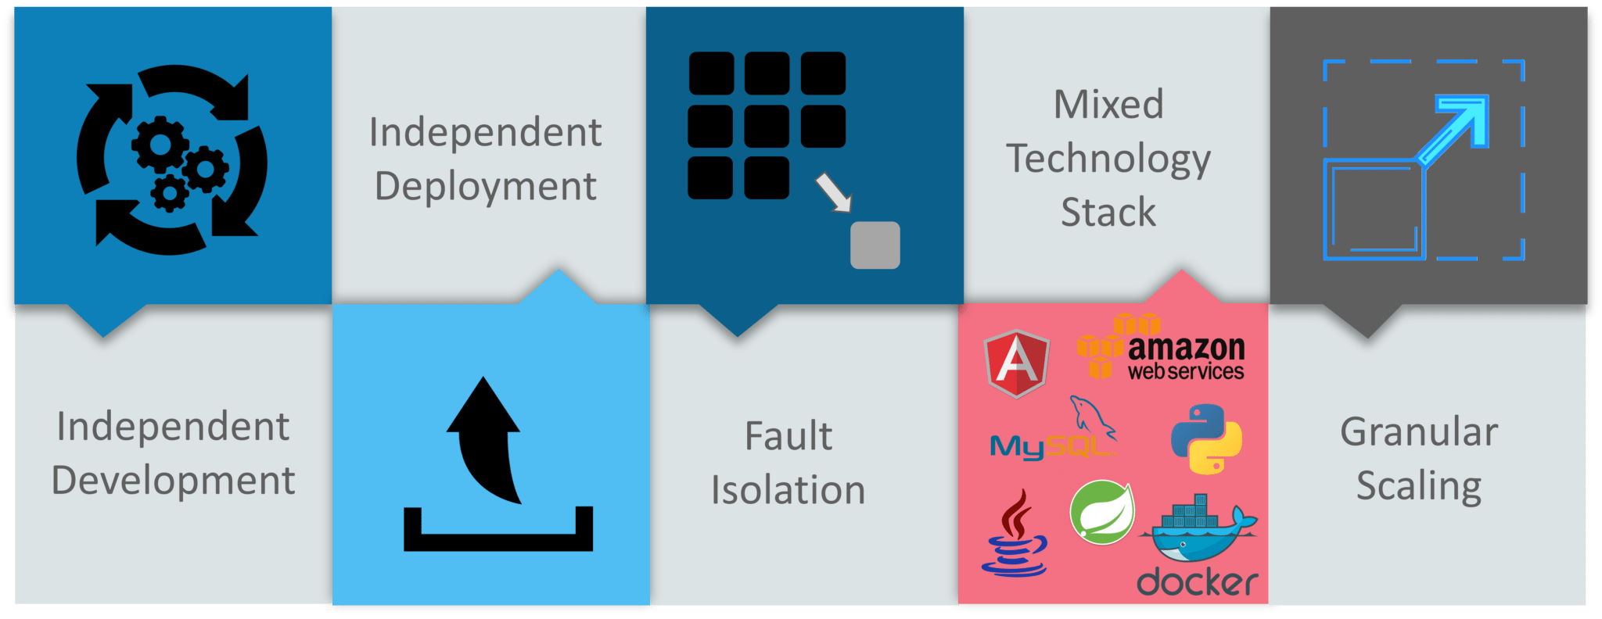
Advantages Of Microservices

Slide 62
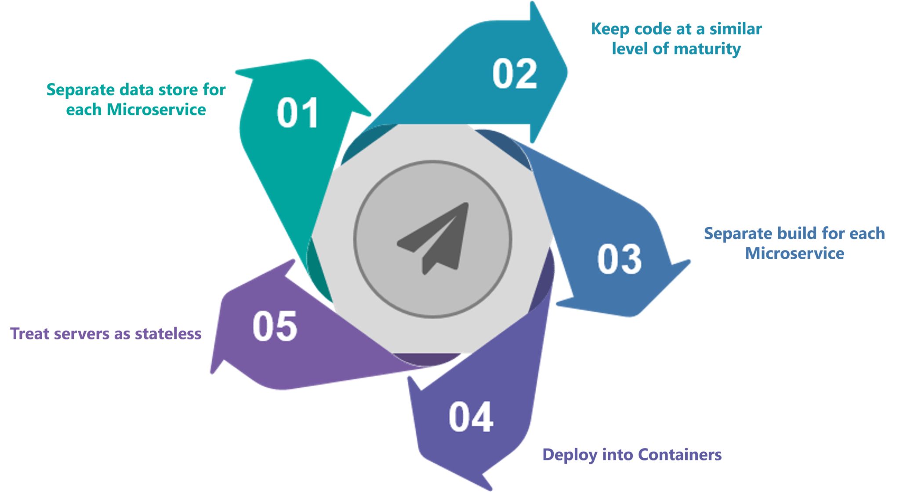
Best Practices To Design Microservices

Slide 63
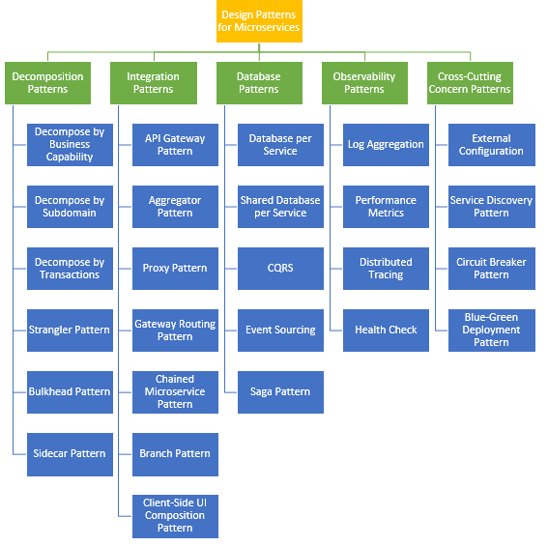
Design Patterns of Micro services

Slide 64
Decomposition Patterns

Slide 65
Decompose by Business Capability
Problem
Microservices is all about making services loosely coupled, applying the single responsibility principle.
However, breaking an application into smaller pieces has to be done logically.
How do we decompose an application into small services?

Slide 66
Decompose by Business Capability
Solution
One strategy is to decompose by business capability.
A business capability is something that a business does in order to generate value.
The set of capabilities for a given business depend on the type of business.
For example, the capabilities of an insurance company typically include sales, marketing, underwriting, claims processing, billing, compliance, etc.
Each business capability can be thought of as a service, except it’s business-oriented rather than technical.

Slide 67
Decompose by Business Capability
Microservice is all about making services loosely coupled, applying the single responsibility principle.
It decomposes by business capability.
Define services corresponding to business capabilities.
A business capability is a concept from business architecture modeling.
A business capability often corresponds to a business object, e.g.
Order Management is responsible for orders
Customer Management is responsible for customers.
For instance, in an e-commerce solution, the main business capabilities are order management, product promotions, service management and others. We can create microservices based on these.

Slide 68
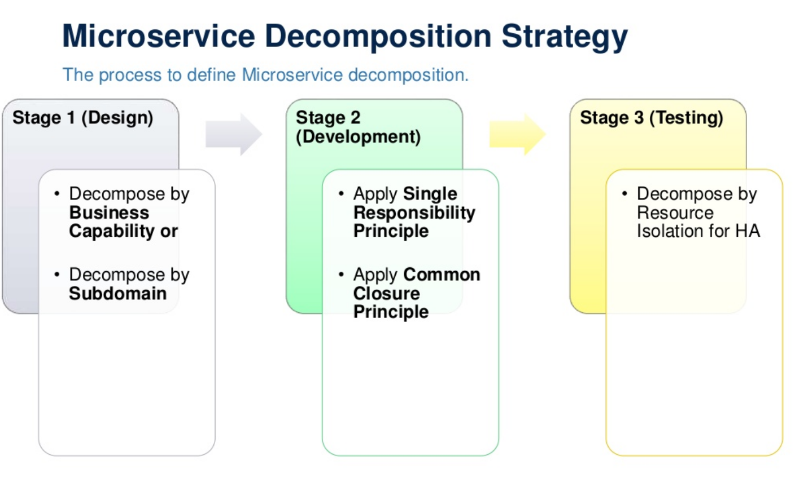

Slide 69
Decompose by Subdomain
Decomposing an application using business capabilities might be a good start, but there will be so-called “God Classes” which will not be easy to decompose.
These classes will be common among multiple services.
A domain consists of multiple subdomains.
Each subdomain corresponds to a different part of the business.

Slide 70
Decompose by Subdomain
Subdomains can be classified as follows:
Core — key differentiator for the business and the most valuable part of the application
Supporting — related to what the business does but not a differentiator. These can be implemented in-house or outsourced
Generic — not specific to the business and are ideally implemented using off the shelf software

Slide 71
Decompose by Subdomain
The subdomains of an Order management include:
Product catalog service
Inventory management services
Order management services
Delivery management services

Slide 72
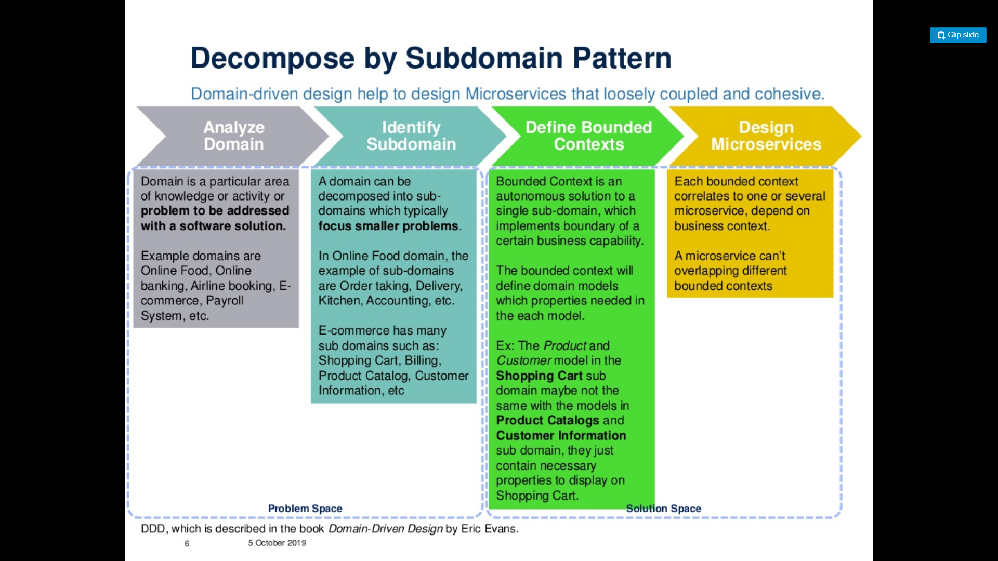
Decompose by Subdomain

Slide 73
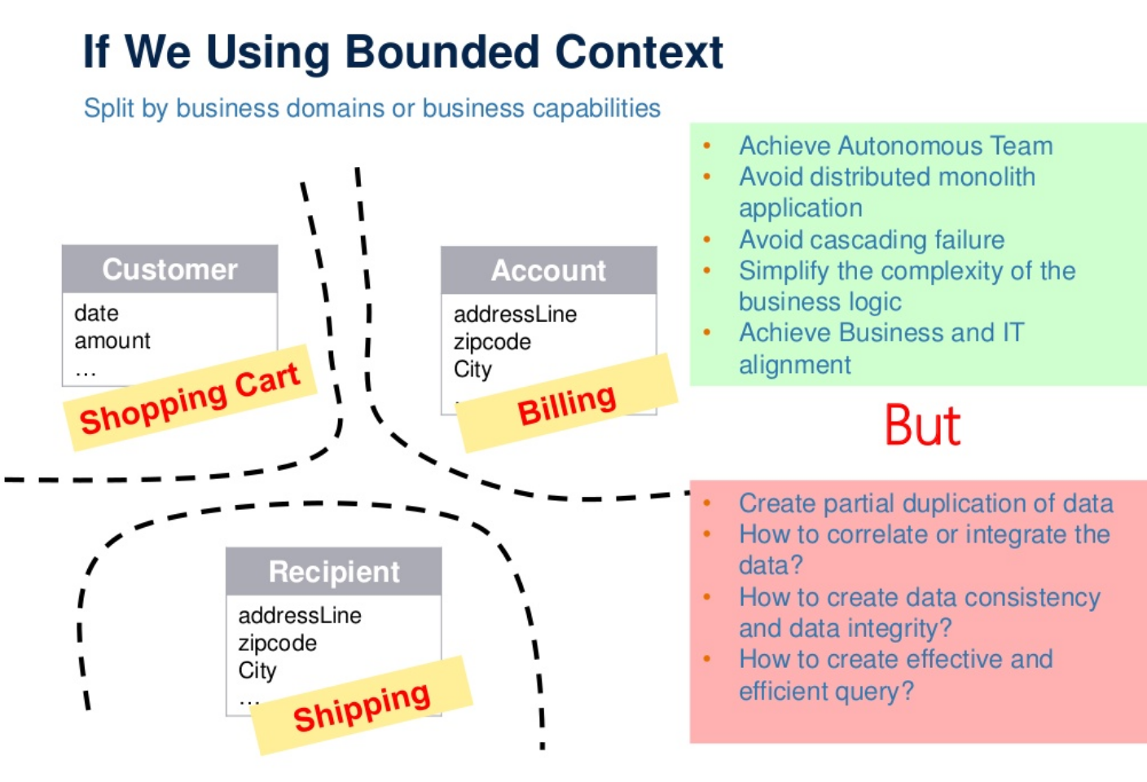
Decompose by Subdomain

Slide 74
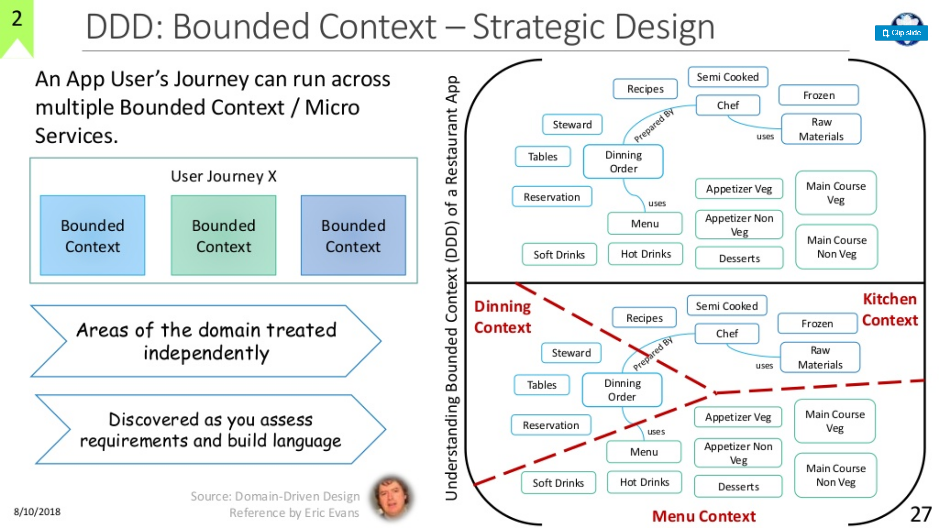
Decompose by Subdomain

Slide 75
Decompose by Transactions / Two-phase commit (2pc) pattern
Identify the main transactions of the application and develop microservices for them.
For instance, the main transactions of an e-commerce application are login, checkout, search and such; We can create microservices for these transactions.

Slide 76
Decompose by Transactions / Two-phase commit (2pc) pattern
You can decompose services over the transactions.
Then there will be multiple transactions in the system.
The distributed transaction consists of two steps:
Prepare phase — during this phase, all participants of the transaction prepare for commit and notify the coordinator that they are ready to complete the transaction
Commit or Rollback phase — during this phase, either a commit or a rollback command is issued by the transaction coordinator to all participants

Slide 77
Decompose by Transactions / Two-phase commit (2pc) pattern
The problem with 2PC is that it is quite slow compared to the time for operation of a single microservice.
Coordinating the transaction between microservices, even if they are on the same network, can really slow the system down, so this approach isn’t usually used in a high load scenario.

Slide 78
Decomposition based on resources
We can create microservices based on nouns or resources and define the operations.
For instance, in an e-commerce solution, ‘products’ is a resource and we can define the list all products
(GET /products), query particular product (GET /product/{1}), insert product (PUT /product/{}).

Slide 79
Strangler Pattern
This creates two separate applications that live side by side in the same URI space.
Over time, the newly refactored application “strangles” or replaces the original application and shuts off monolithic application.
Application steps are transform, coexist, and eliminate:
Transform — Create a parallel new site with modern approaches.
Coexist — Leave the existing site where it is for a time. Redirect from the existing site to the new one so the functionality is implemented incrementally.
Eliminate — Remove the old functionality from the existing site.

Slide 80
Strangler Pattern

Slide 81
Bulkhead Pattern
Isolate elements of an application into pools so that if one fails, the others will continue to function.
This pattern is named Bulkhead because it resembles the sectioned partitions of a ship’s hull.
Partition service instances into different groups, based on consumer load and availability requirements.
This design helps to isolate failures, and gives sustain service functionality for some consumers, even during a failure.

Slide 82
Bulkhead Pattern
Bulkhead is a term borrowed from cargo ships.
In a cargo ship, the bulkhead is a wall built between different cargo sections, which makes sure that a fire or flood in one section is restricted to that section and other sections are not impacted.
Failure in one service or a group of services should not bring down the whole application.
To implement the bulkhead pattern, we need to make sure that all our services work independently of each other and failure in one will not create a failure in another service.
Techniques such as maintaining a single-responsibility pattern, an asynchronous-communication pattern, or fail-fast and failure-handling patterns help us to achieve ...

Slide 83
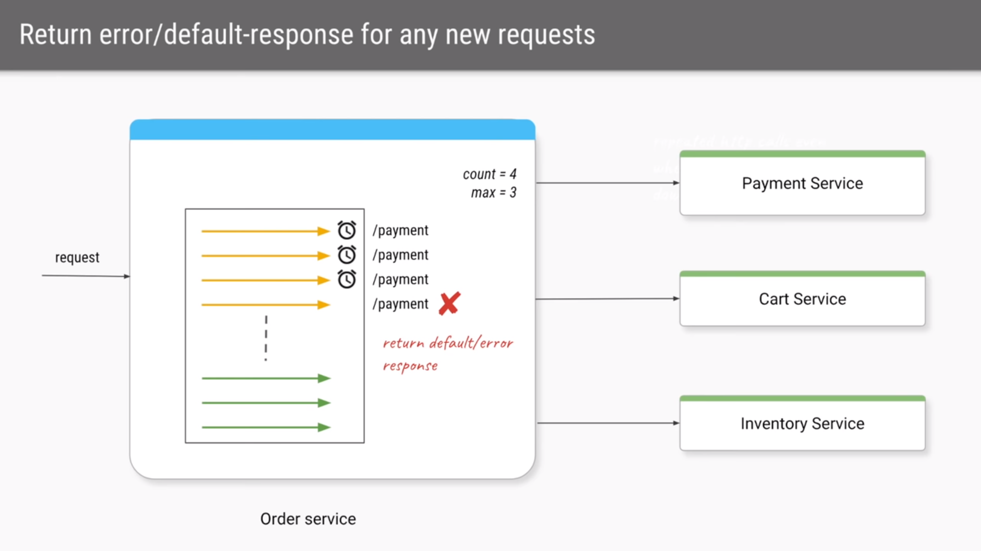
Bulkhead

Slide 84
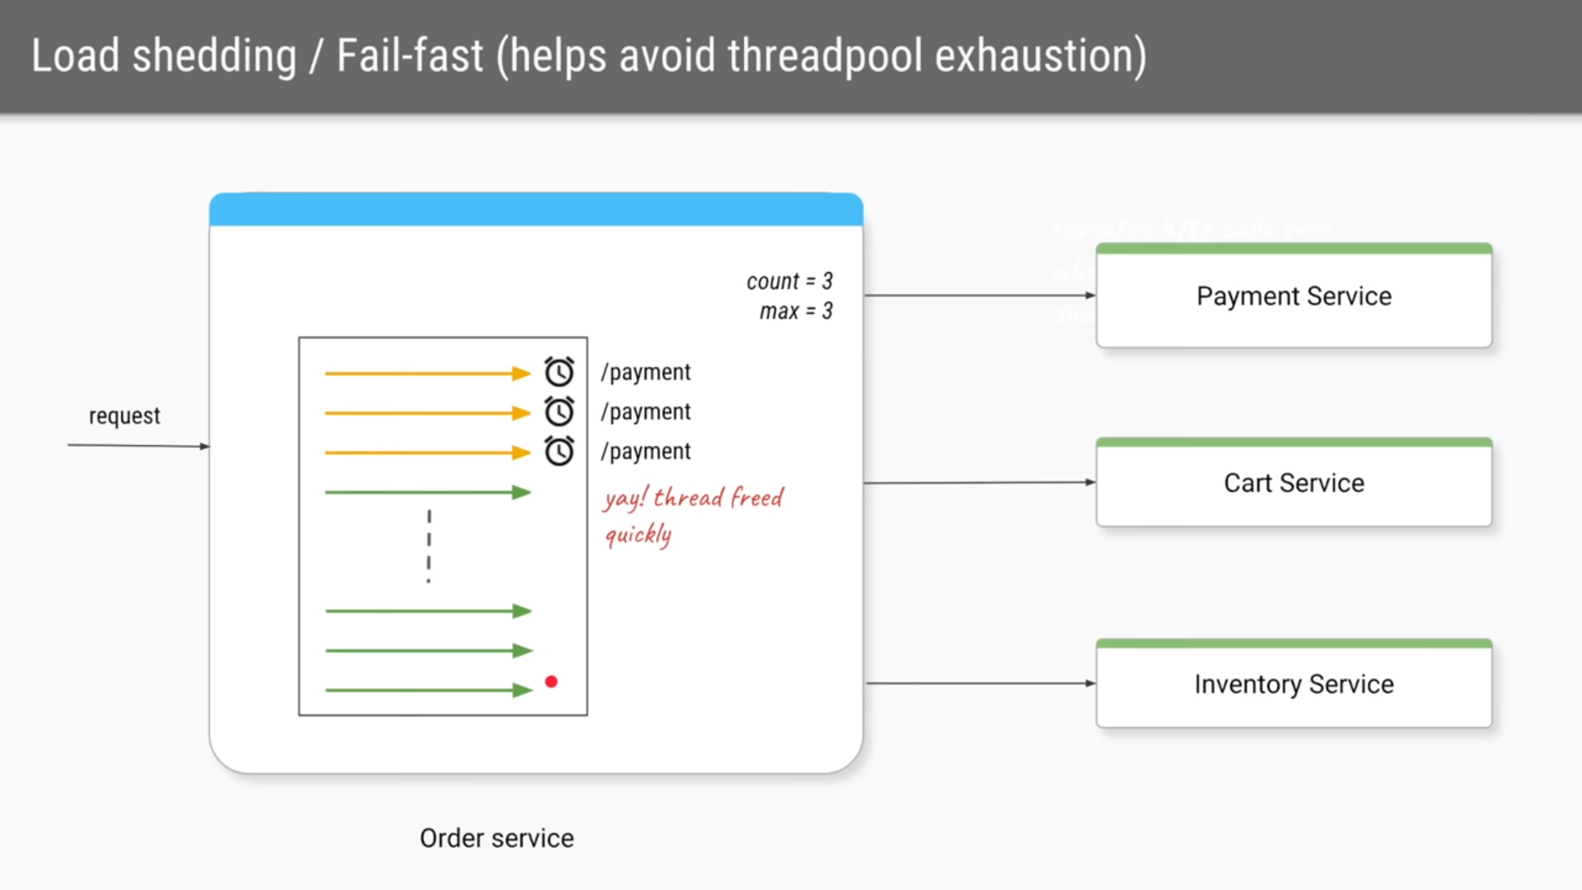
Bulkhead

Slide 85
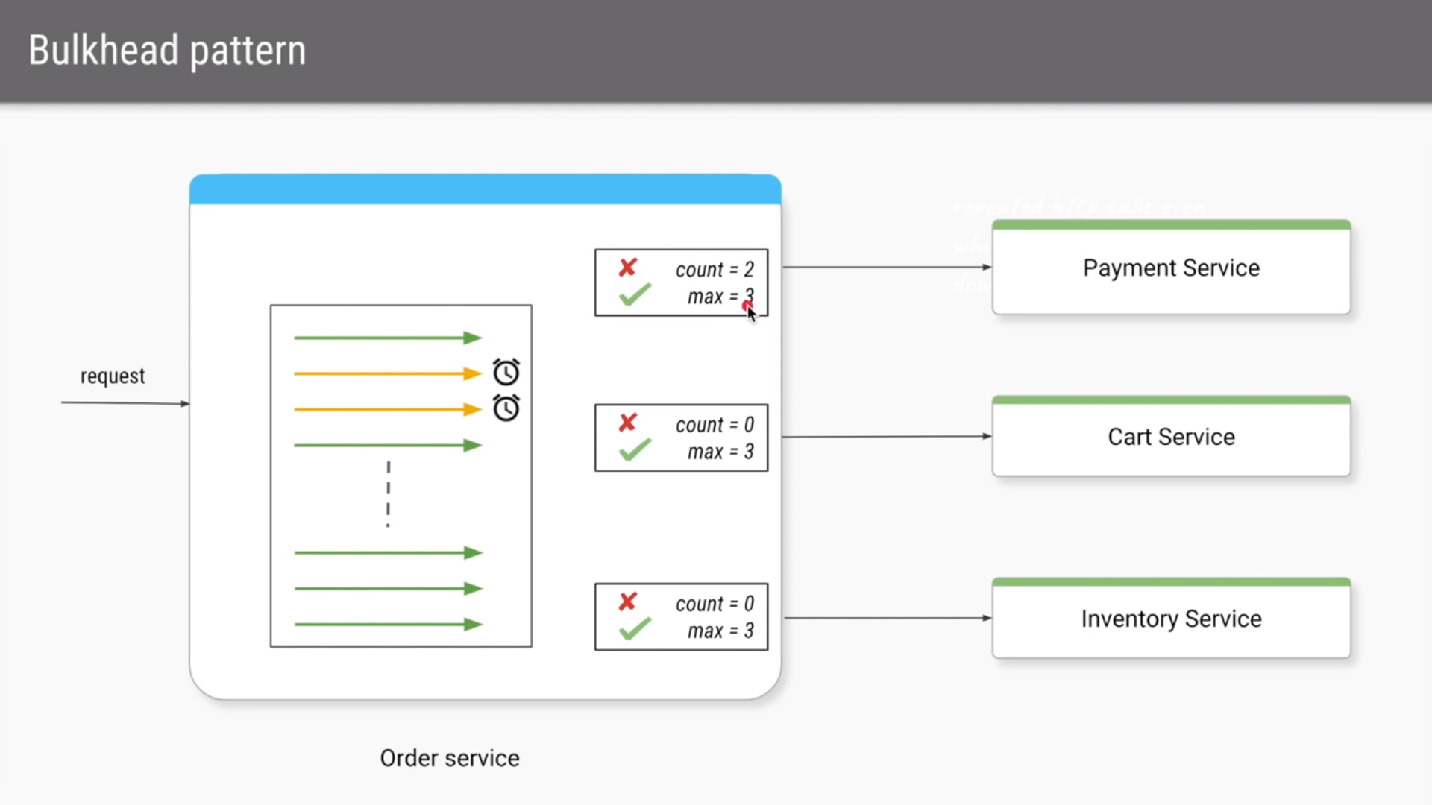
Bulkhead

Slide 86
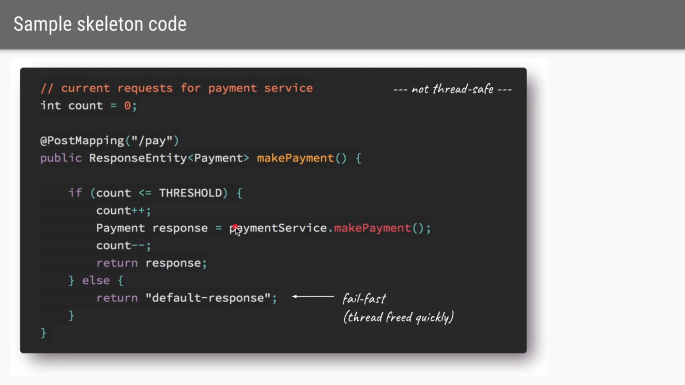
Bulkhead

Slide 87
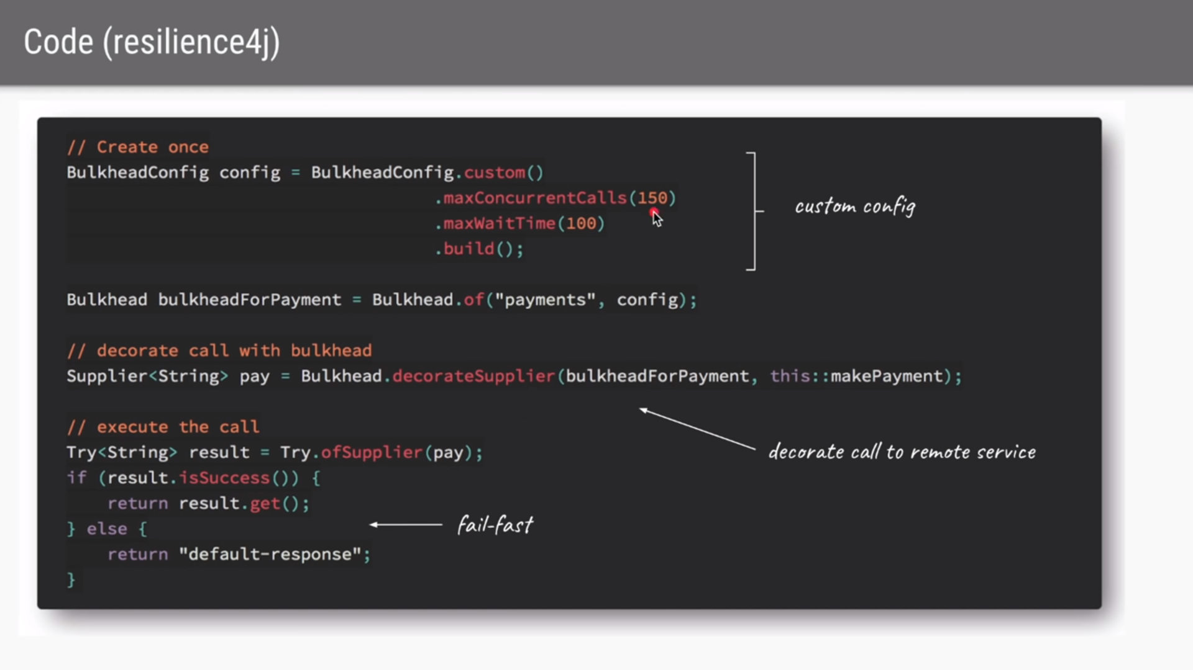
Bulkhead

Slide 88
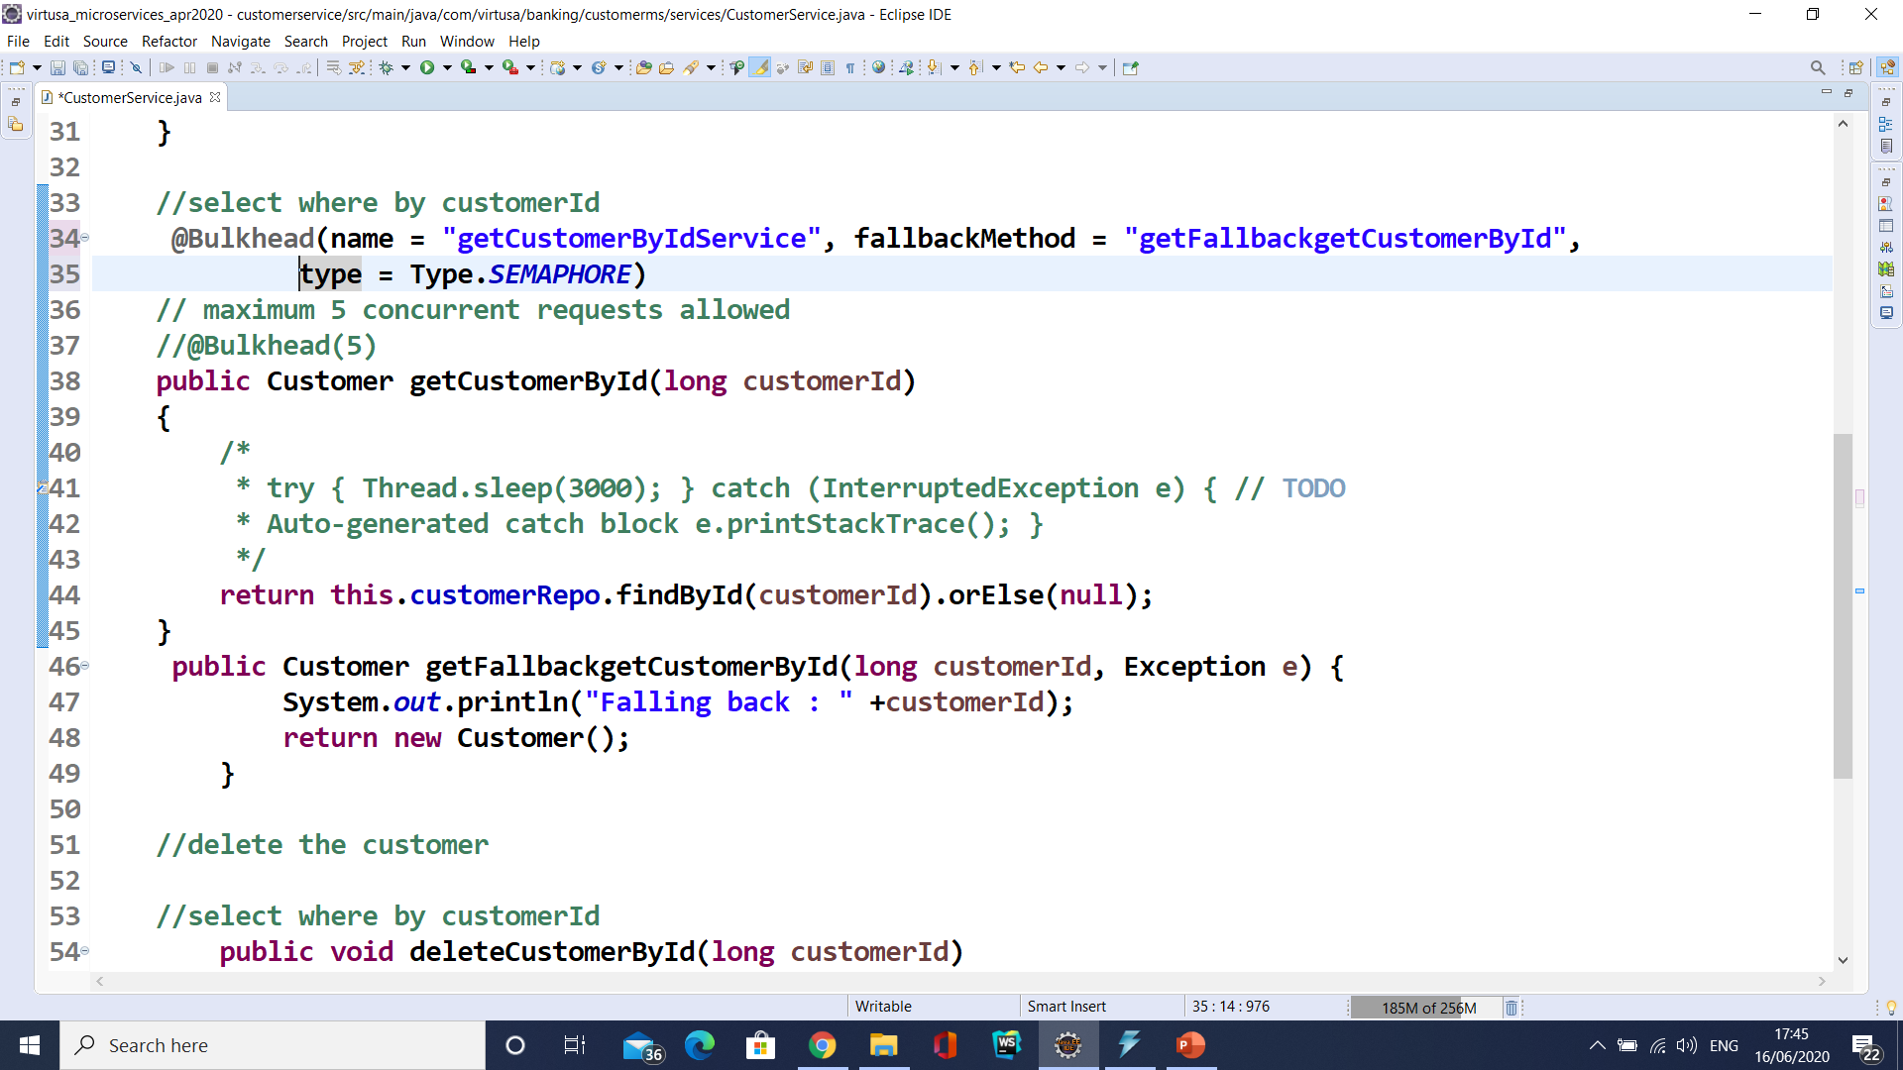
Bulkhead

Slide 89
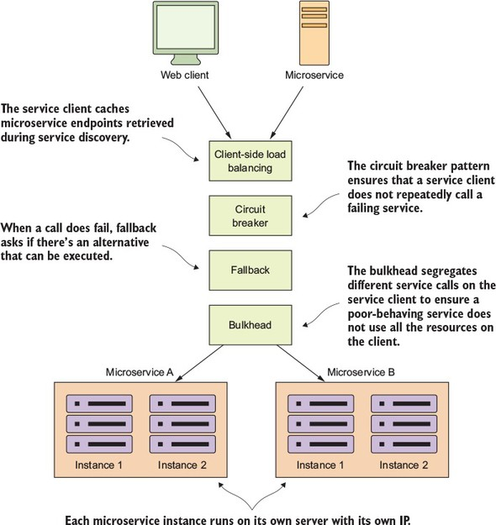
Bulkhead Pattern

Slide 90
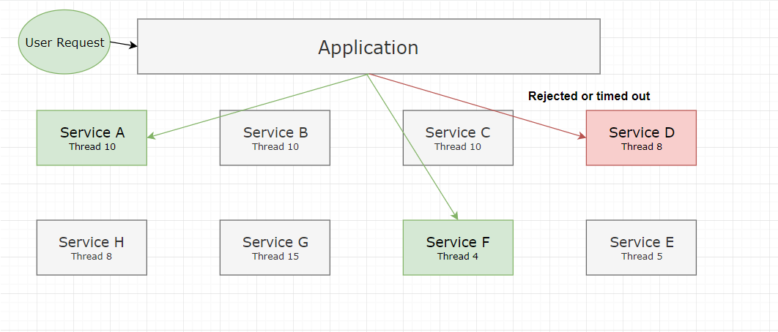
Bulkhead Pattern

Slide 91
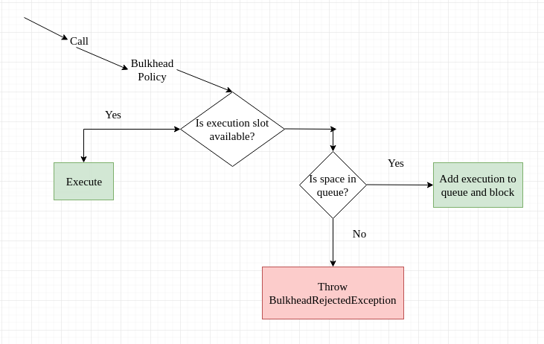
Bulkhead Pattern

Slide 92
Sidecar Pattern
Deploy components of an application into a separate processor container to provide isolation and encapsulation.
This pattern can also enable applications to be composed of heterogeneous components and technologies.
This pattern is named Sidecar because it resembles a sidecar attached to a motorcycle.
In the pattern, the sidecar is attached to a parent application and provides supporting features for the application.
The sidecar also shares the same lifecycle as the parent application, is created and retired alongside the parent.
The sidecar pattern is sometimes referred to as the sidekick pattern and is the last decomposition pattern.

Slide 93
Sidecar Pattern
The problem statement
There are multiple problems related to inter service communication when polyglot comes into picture. few of them are:
How does non-JVM apps discover JVM microservices in Spring Cloud environment and vice-versa.
In any cloud native application, we would never want to hard code host and port of apps for discovery purpose.
How does non-JVM app communicates (i.e. calls REST endpoints) with JVM apps and vice versa.
How do we utilize the client side load balancing features for non-JVM apps.
How do we utilize the config server for non-JVM apps?

Slide 94
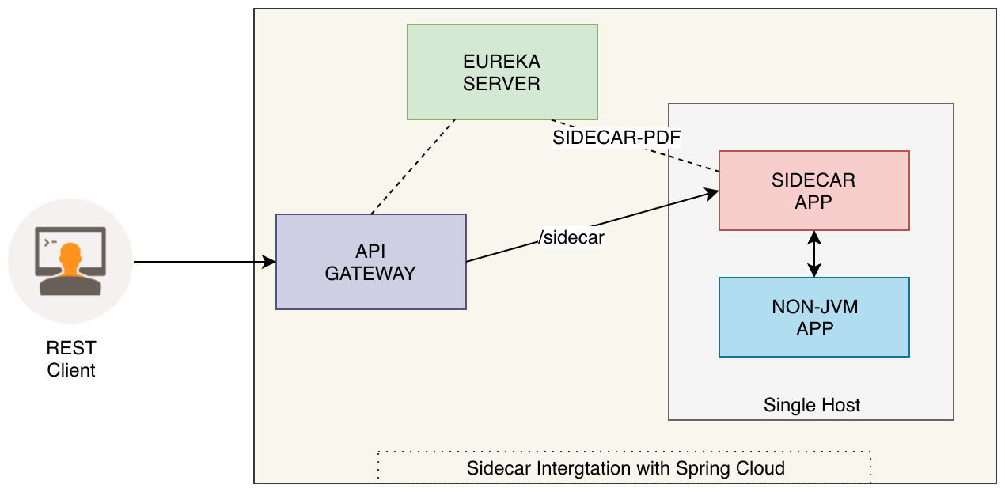
Sidecar for the Rescue

Slide 95
Integration Patterns

Slide 96
API Gateway Pattern
An API gateway provides a centralized access point for invoking a microservice.
The API gateway handles security (such as authentication, authorization), governance (such as logging service, monitoring service), request routing, protocol transformation, data transformation and the aggregation of responses from multiple services.

Slide 97
API Gateway Pattern
An API Gateway helps to address many concerns raised by the microservice implementation.
An API Gateway is the single point of entry for any microservice call.
It can work as a proxy service to route a request to the concerned microservice.
It can aggregate the results to send back to the consumer.
This solution can create a fine-grained API for each specific type of client.
It can also convert the protocol request and respond.
It can also offload the authentication/authorization responsibility of the microservice.

Slide 98

API Gateway Design Pattern

Slide 99
Aggregator Pattern
When breaking the business functionality into several smaller logical pieces of code, it becomes necessary to think about how to collaborate the data returned by each service.
This responsibility cannot be left with the consumer.
The Aggregator pattern helps to address this.
It talks about how we can aggregate the data from different services and then send the final response to the consumer.

Slide 100
Aggregator Pattern
A composite microservice will make calls to all the required microservices, consolidate the data, and transform the data before sending back.
An API Gateway can also partition the request to multiple microservices and aggregate the data before sending it to the consumer.
When a single microservice needs responses from multiple microservices, a composite service can take the responsibility of aggregating the response.

